Slide 1
Happiness Is… & Nine Lives
Pet Portraits by Alyson Kinkade

Slide 2
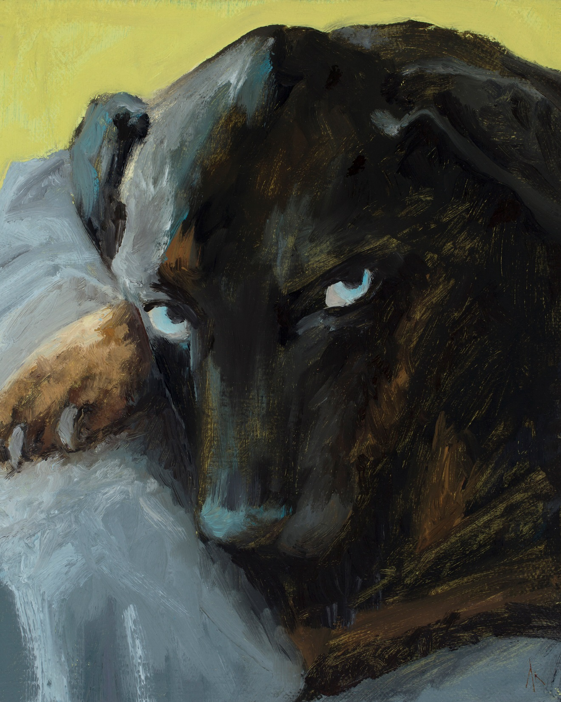
My Happiness Is… series began after my father’s dog Sky passed away in 2014. I painted a portrait of him for Christmas. As I worked on it, he rescued two dogs. So I painted them as well. Then I decided I’d paint portrait gifts for each family member and some close friends to take care of Christmas. Before I knew it, I had 12 portraits and started getting commissions by others. After a year I had painted 36 dogs. I felt it was time to get cats on board too, so I started the Nine Lives series.
They are incredible paintings to work on – very joyful even when it’s for a pet that’s passed on I find them very healing and comforting to work on for me. And presenting the paintings is even more joyful. The recipient usually has tears, but in a good way. Our animals touch us in deep ways and I’m honored to reproduce a small amount of that connection through these paintings.
Happiness Is… Alyson Kinkade Fine Art alysonkinkade.com/happiness-is

Slide 3
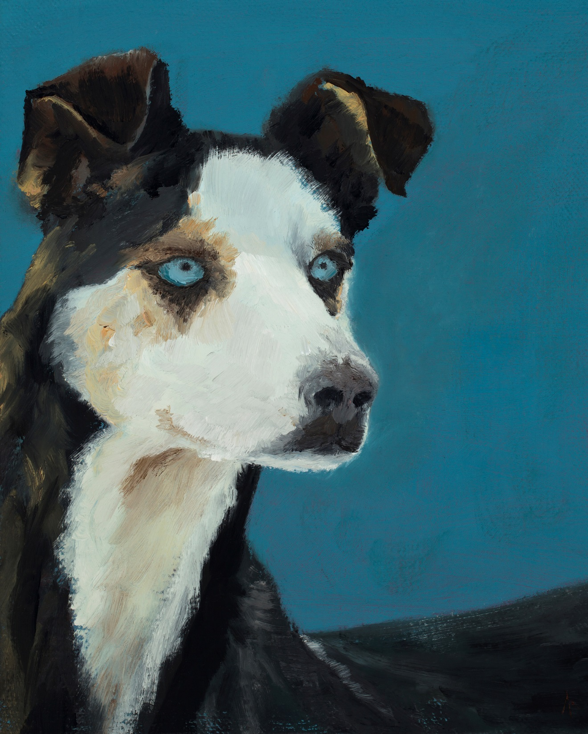
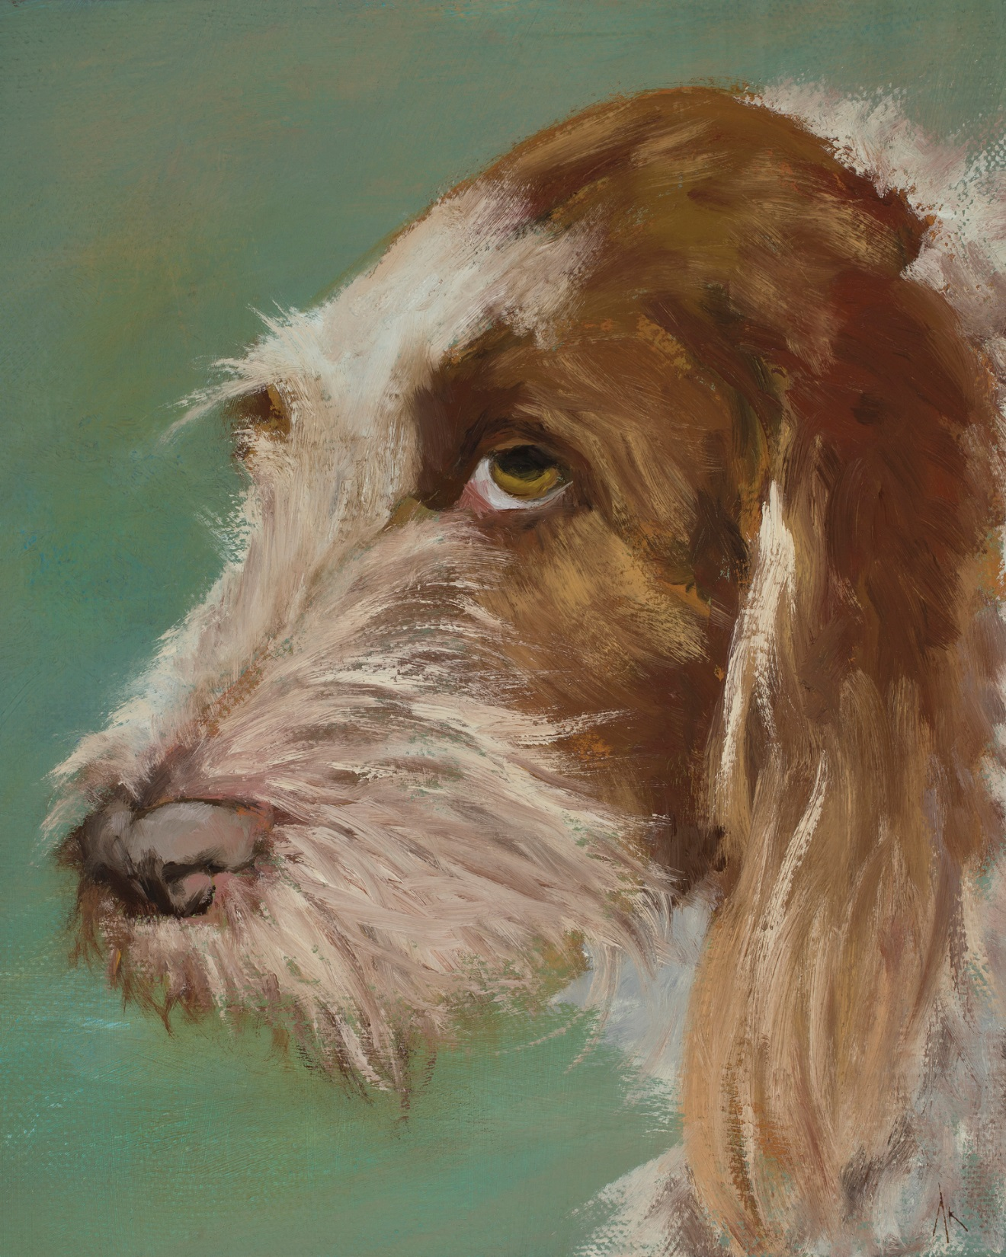
Happiness Is… Alyson Kinkade Fine Art alysonkinkade.com/happiness-is

Slide 4
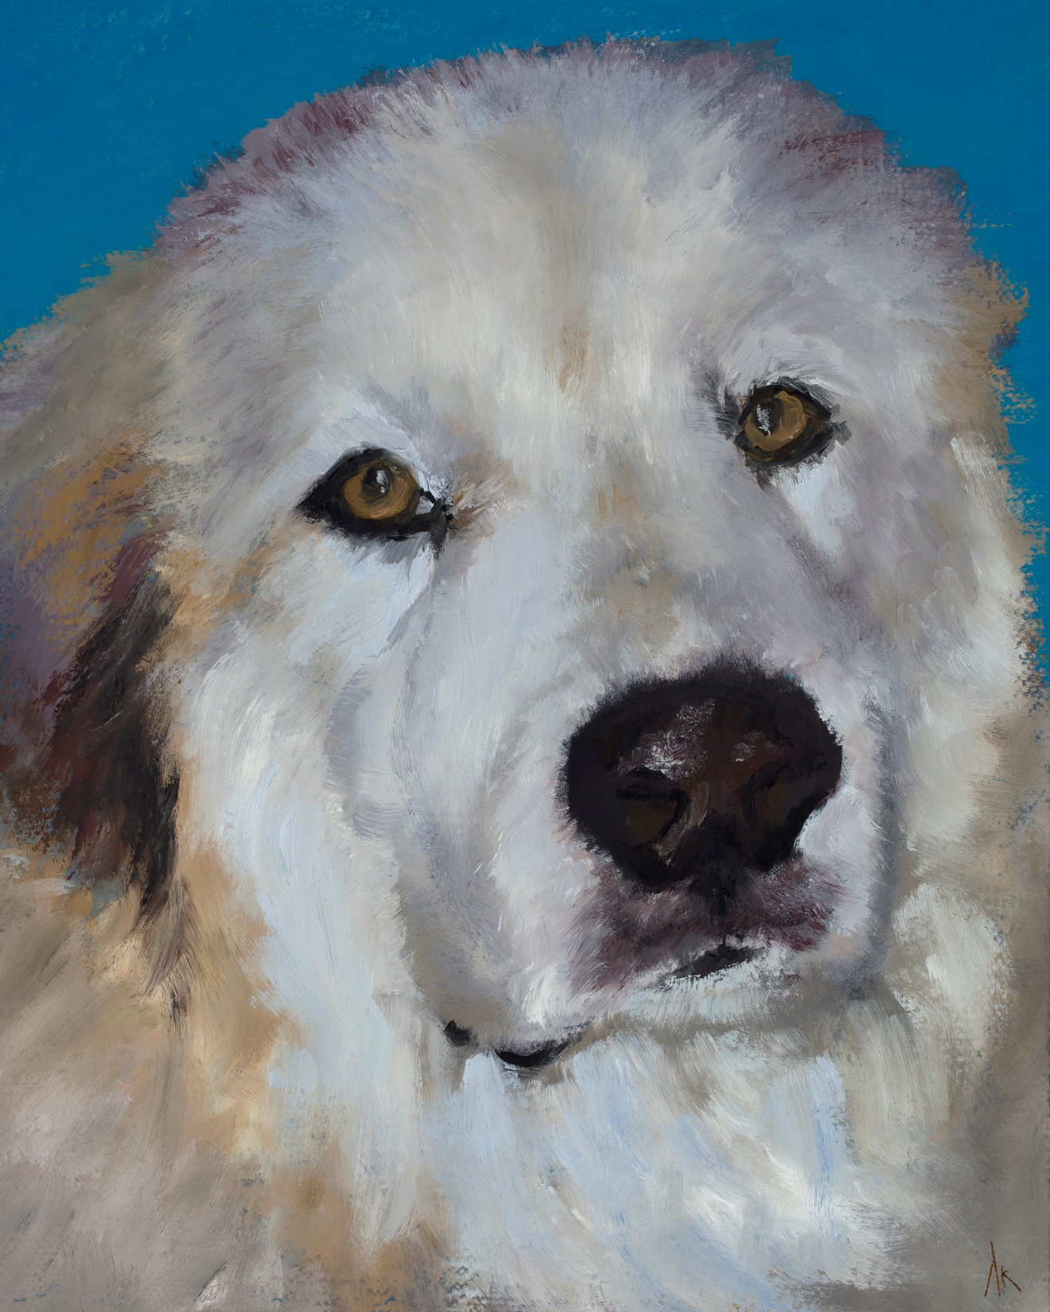
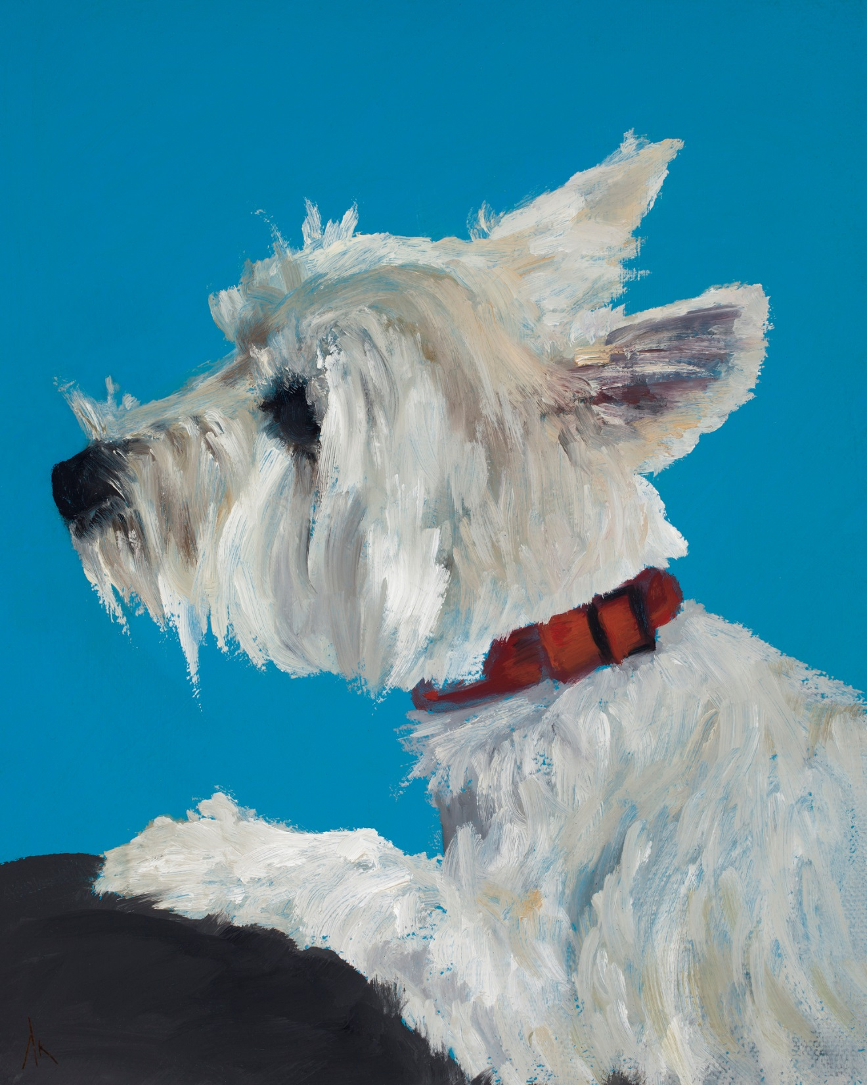
Happiness Is… Alyson Kinkade Fine Art alysonkinkade.com/happiness-is

Slide 5
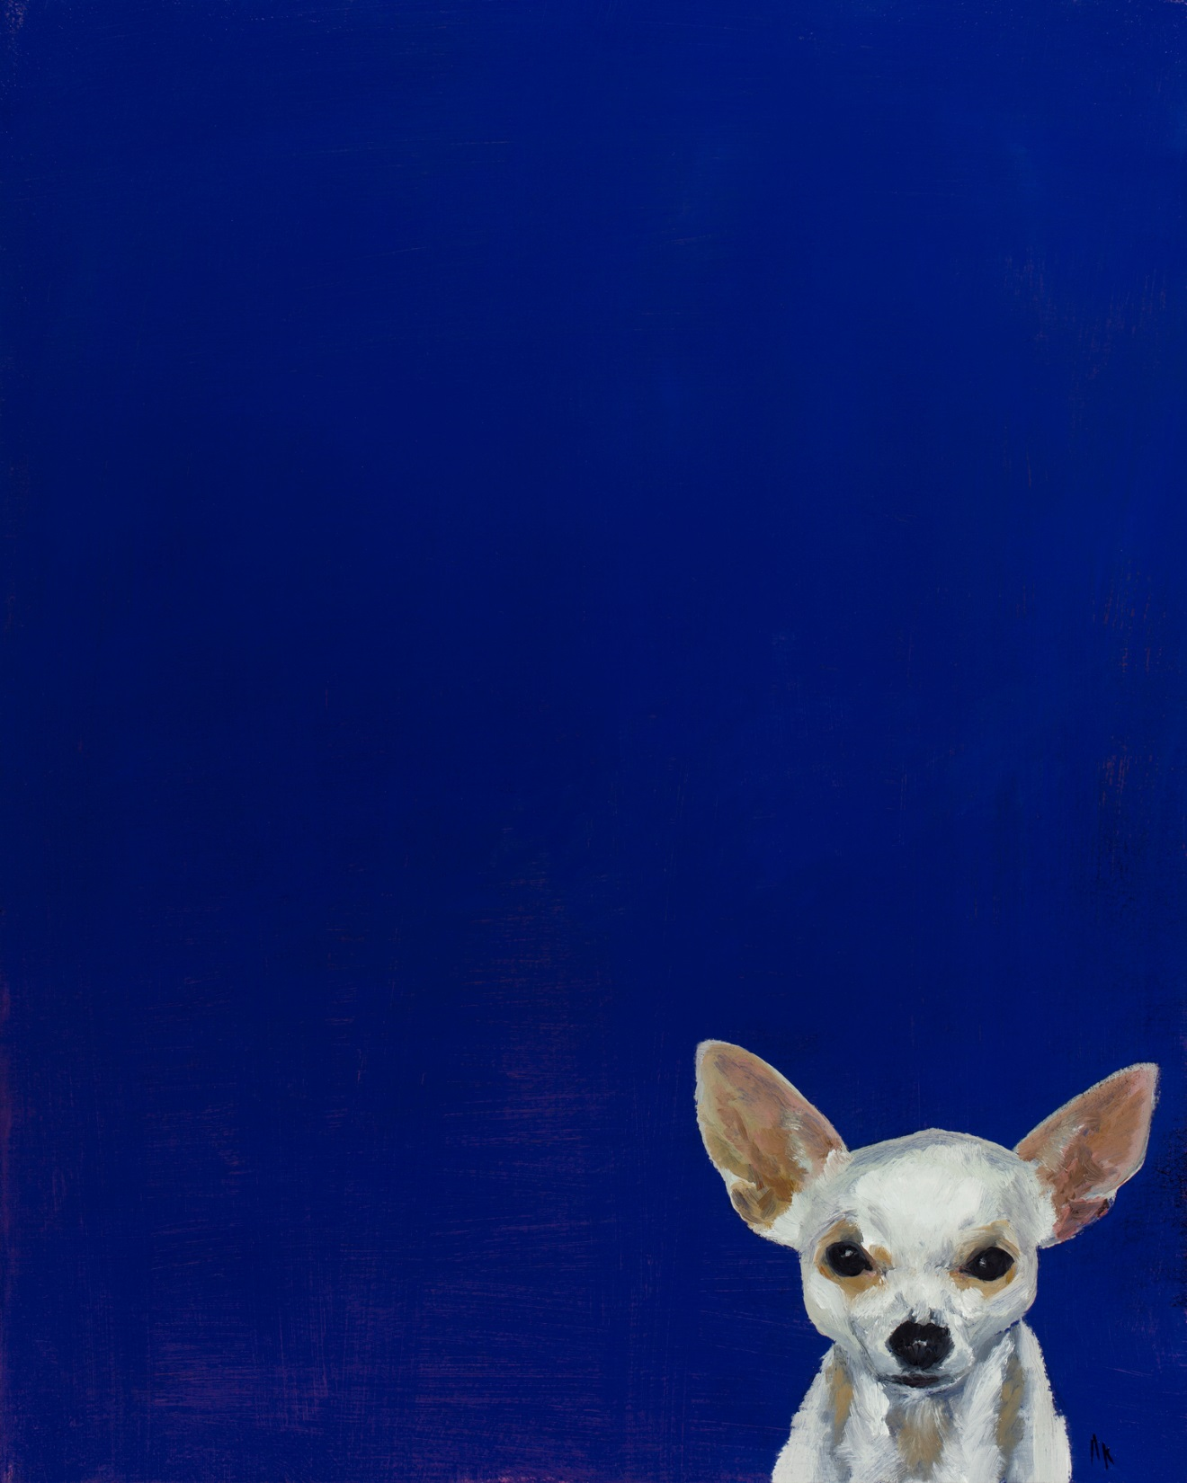
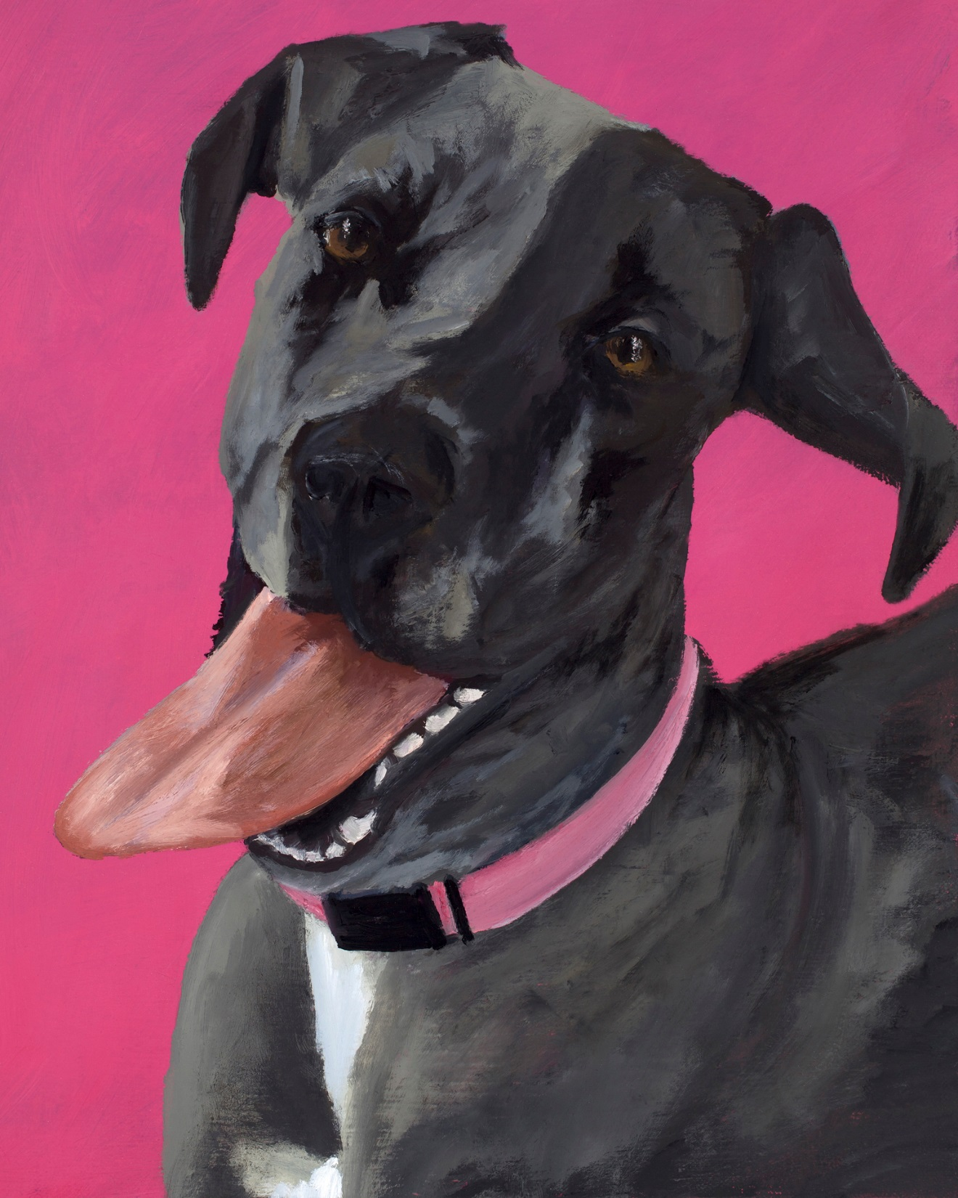
Happiness Is… Alyson Kinkade Fine Art alysonkinkade.com/happiness-is

Slide 6
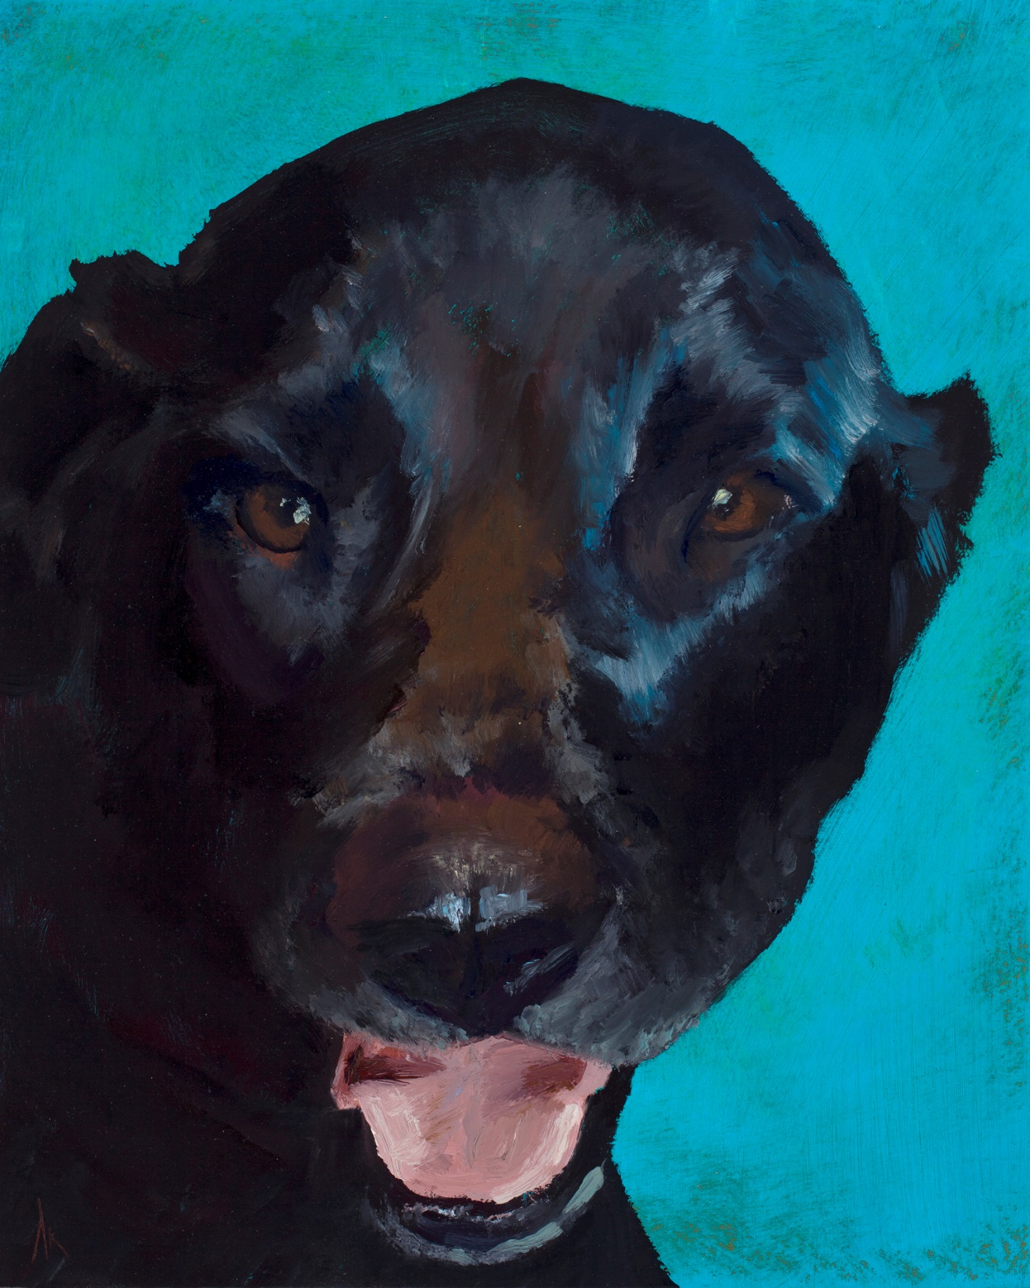
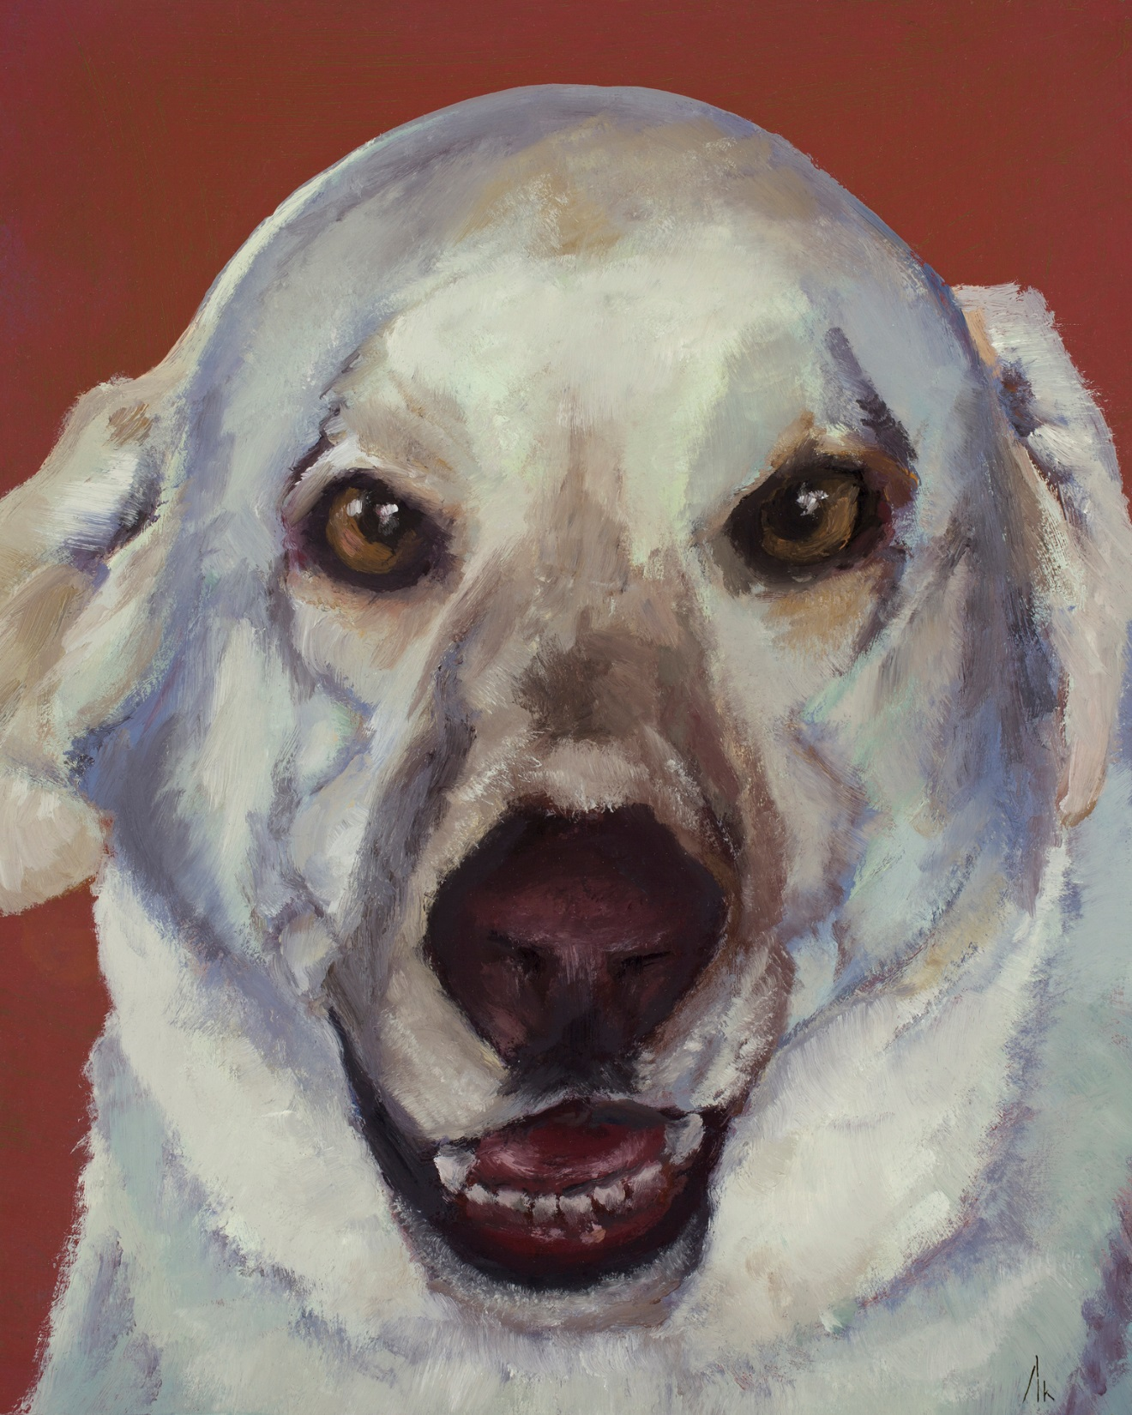
Happiness Is… Alyson Kinkade Fine Art alysonkinkade.com/happiness-is

Slide 7
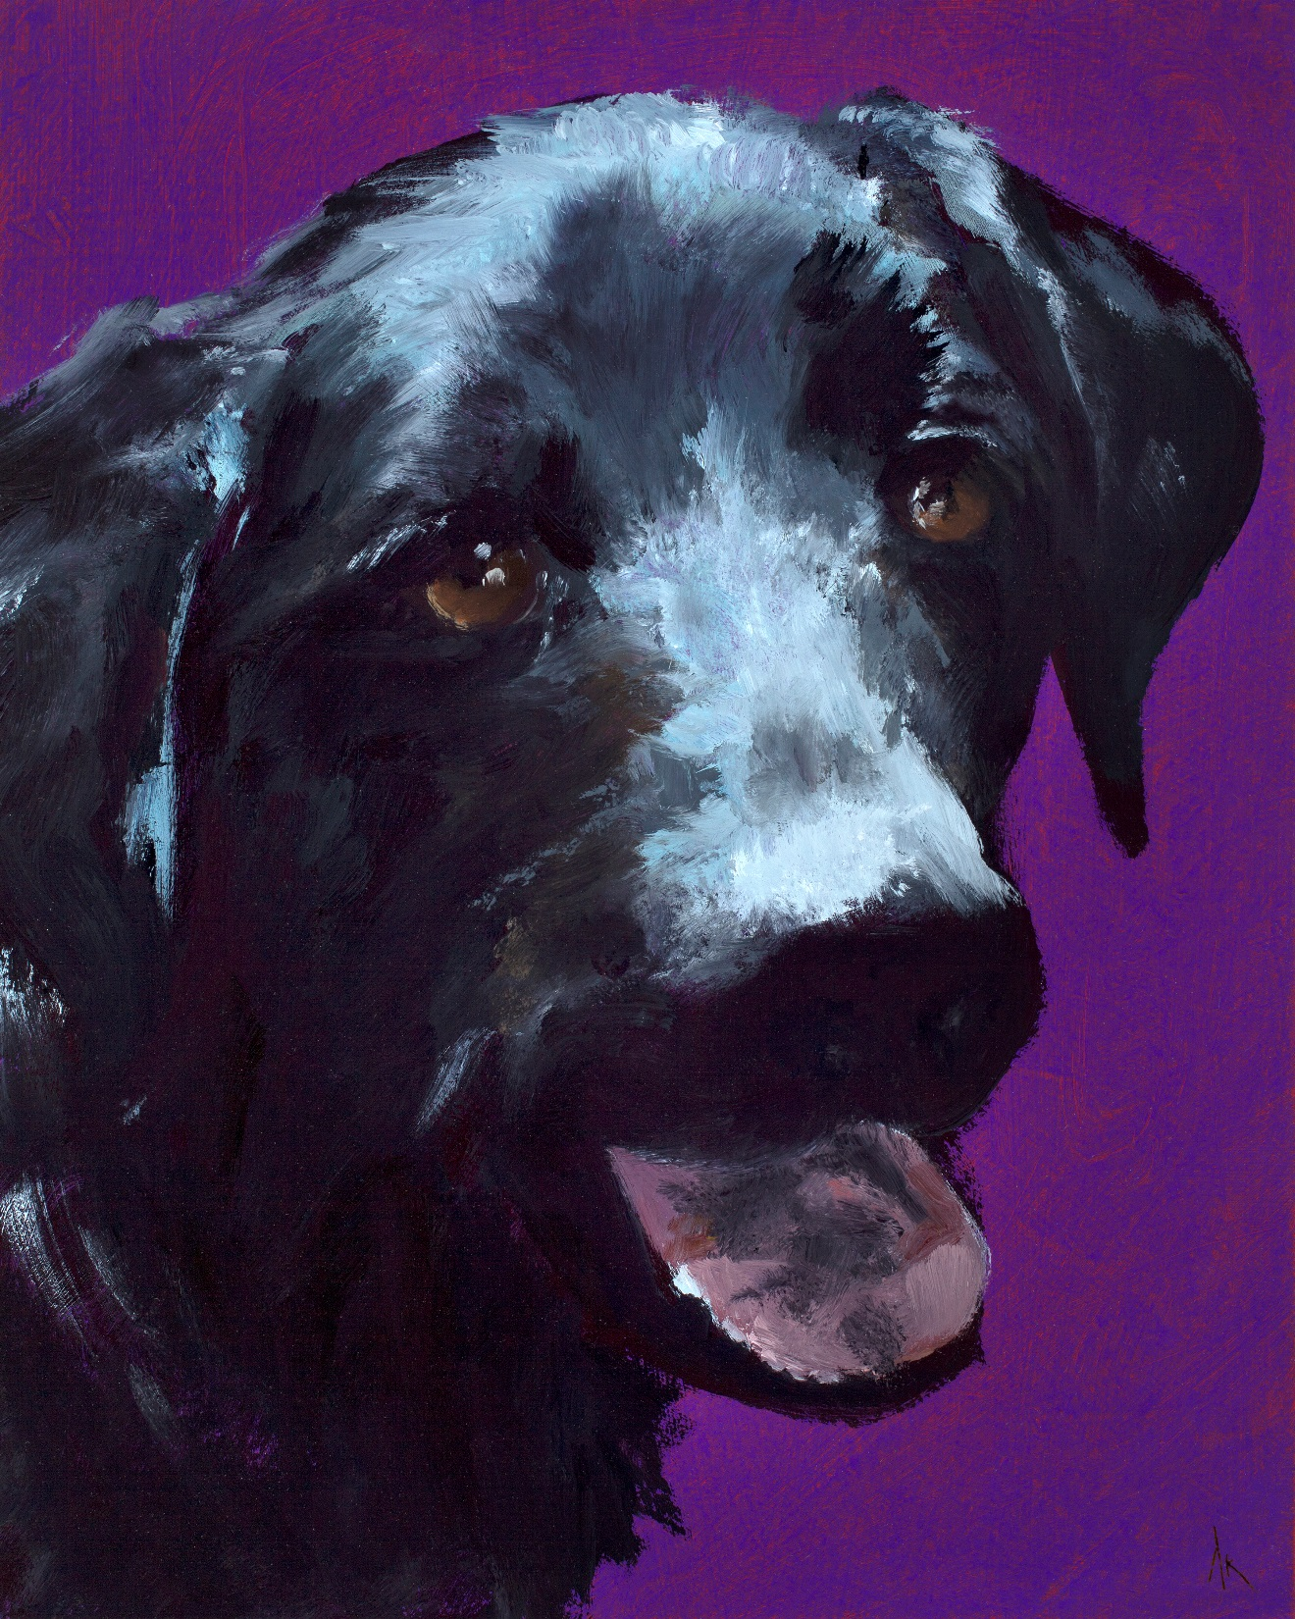
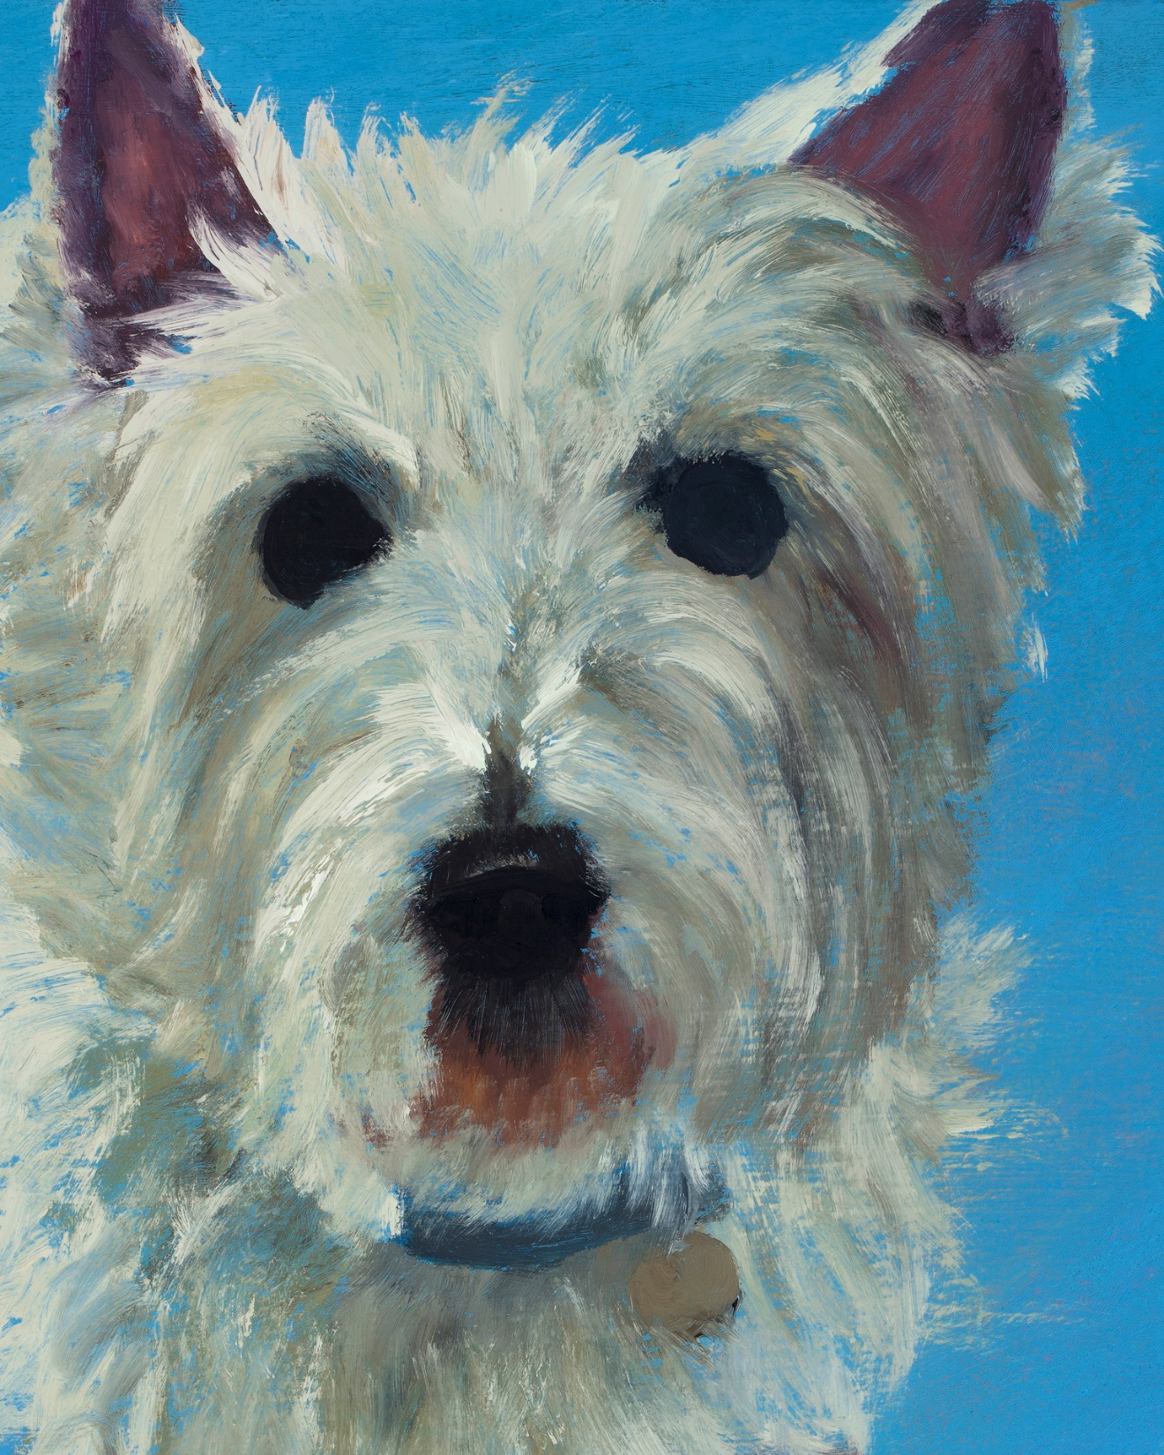
Happiness Is… Alyson Kinkade Fine Art alysonkinkade.com/happiness-is

Slide 8
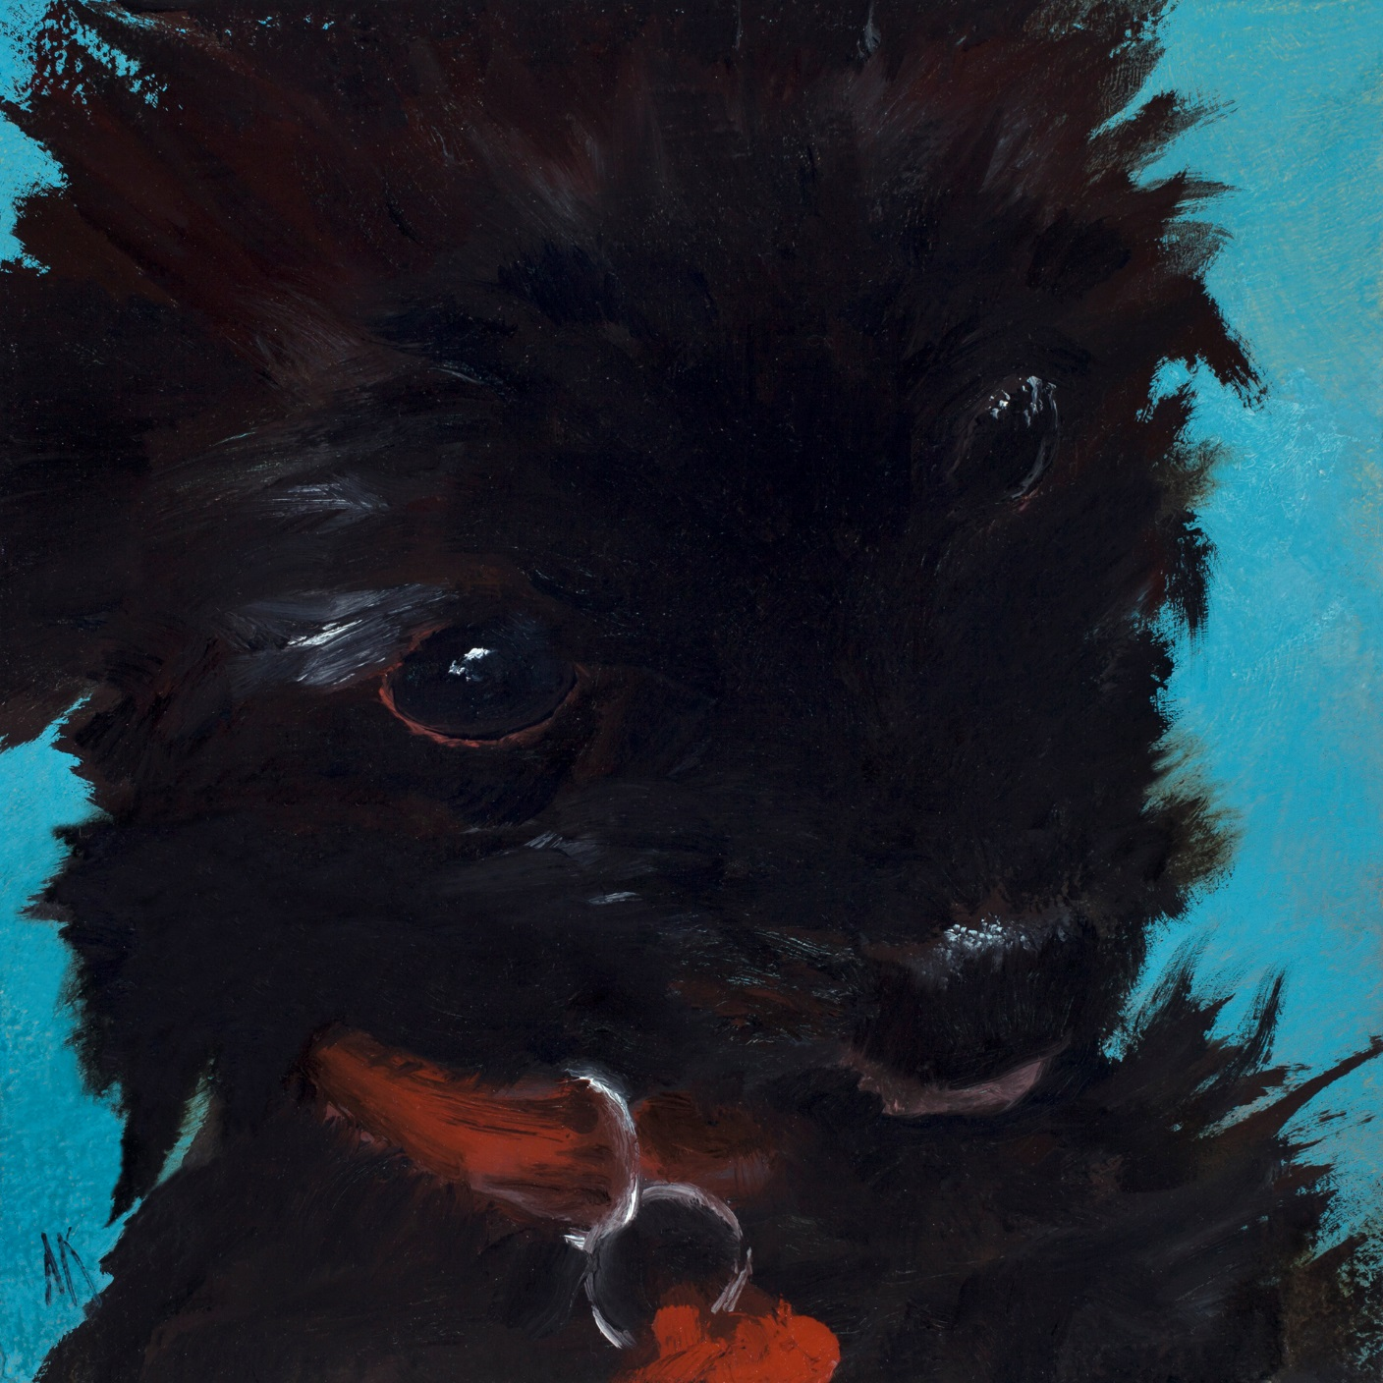
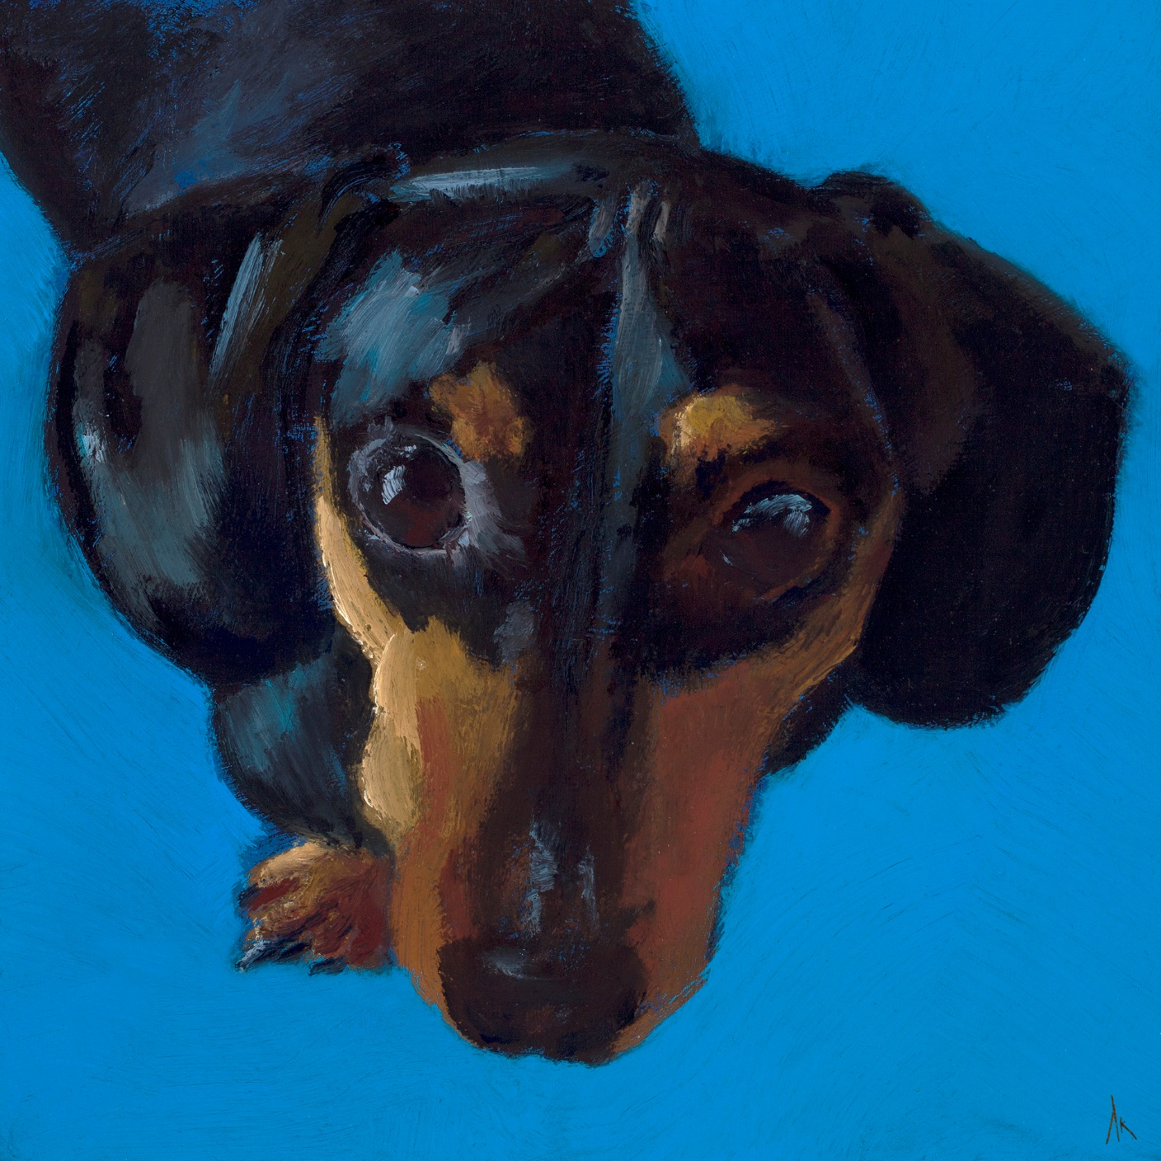
Happiness Is… Alyson Kinkade Fine Art alysonkinkade.com/happiness-is

Slide 9
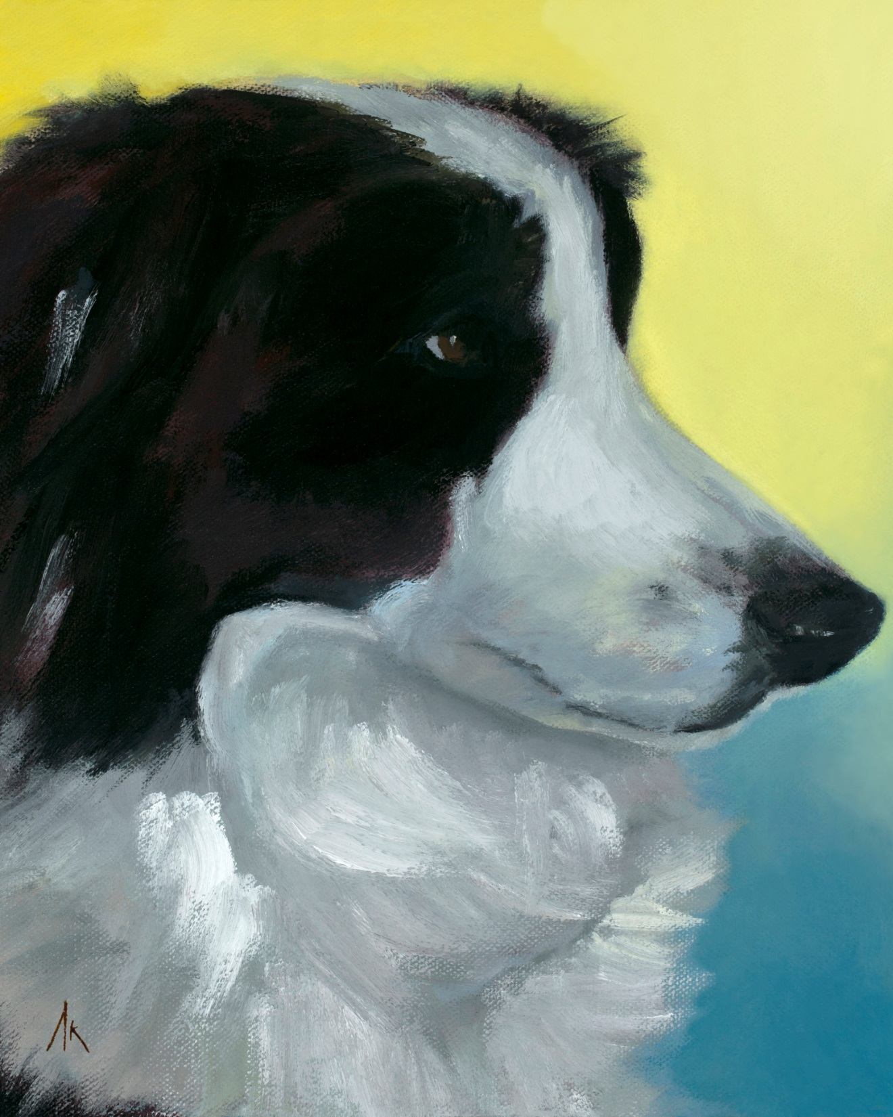
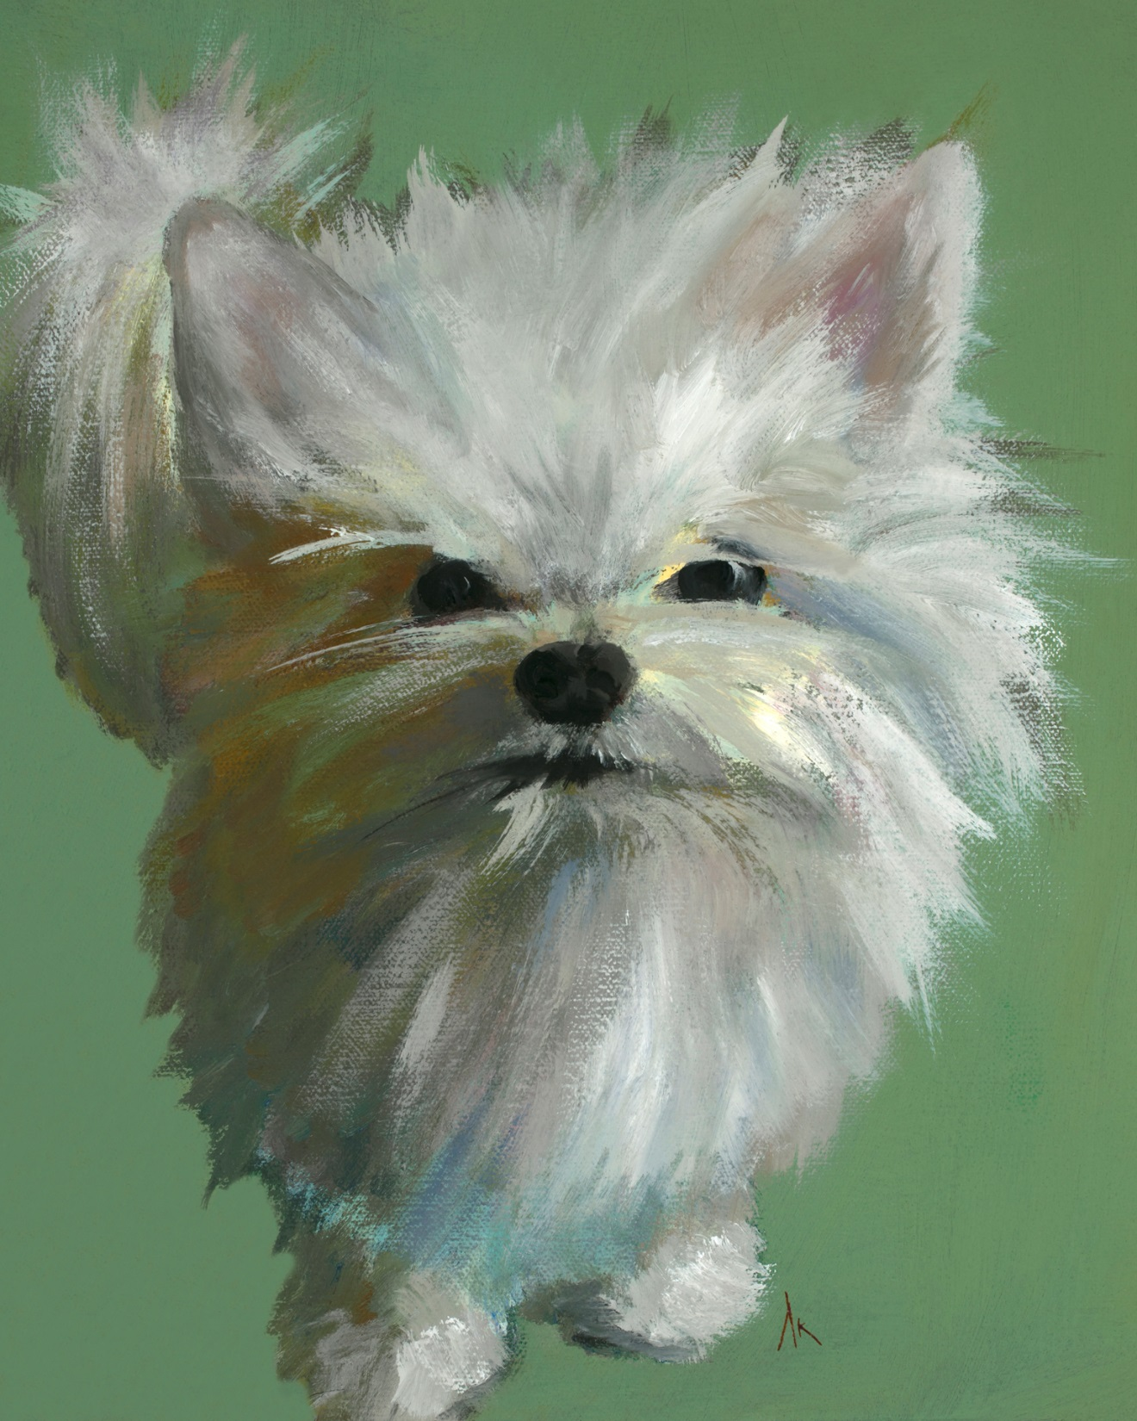
Happiness Is… Alyson Kinkade Fine Art alysonkinkade.com/happiness-is

Slide 10
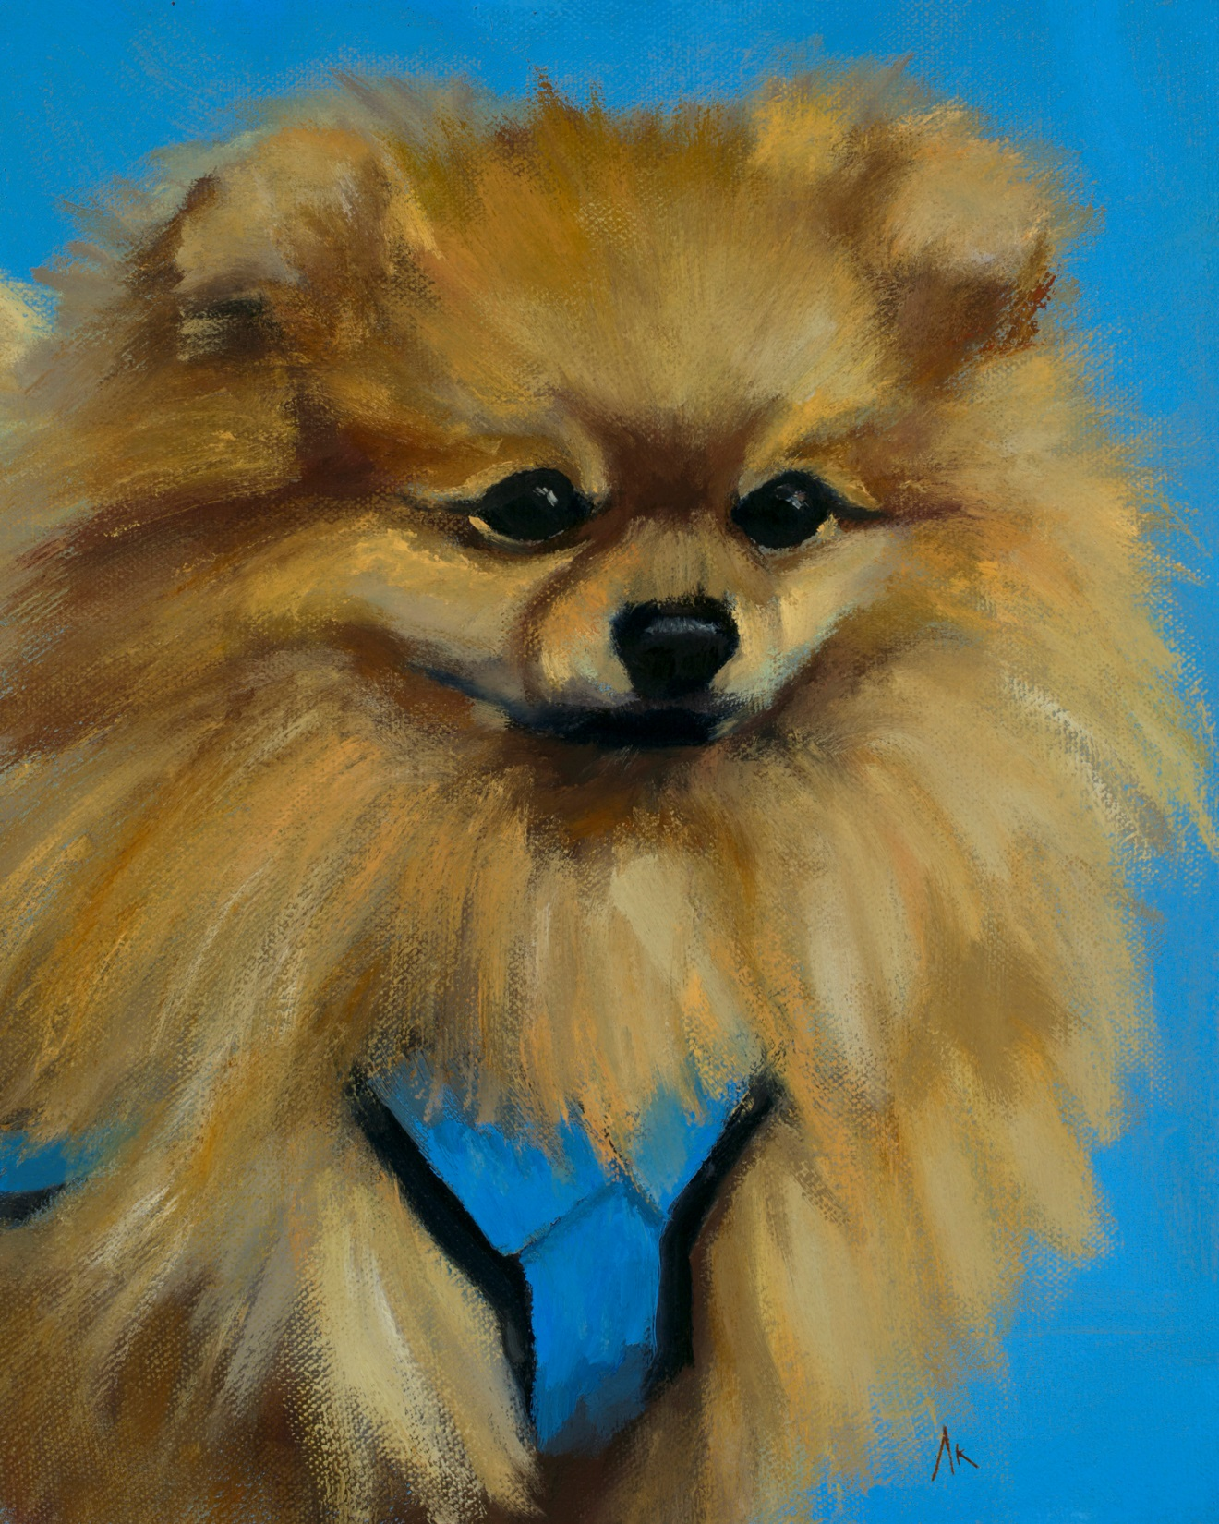
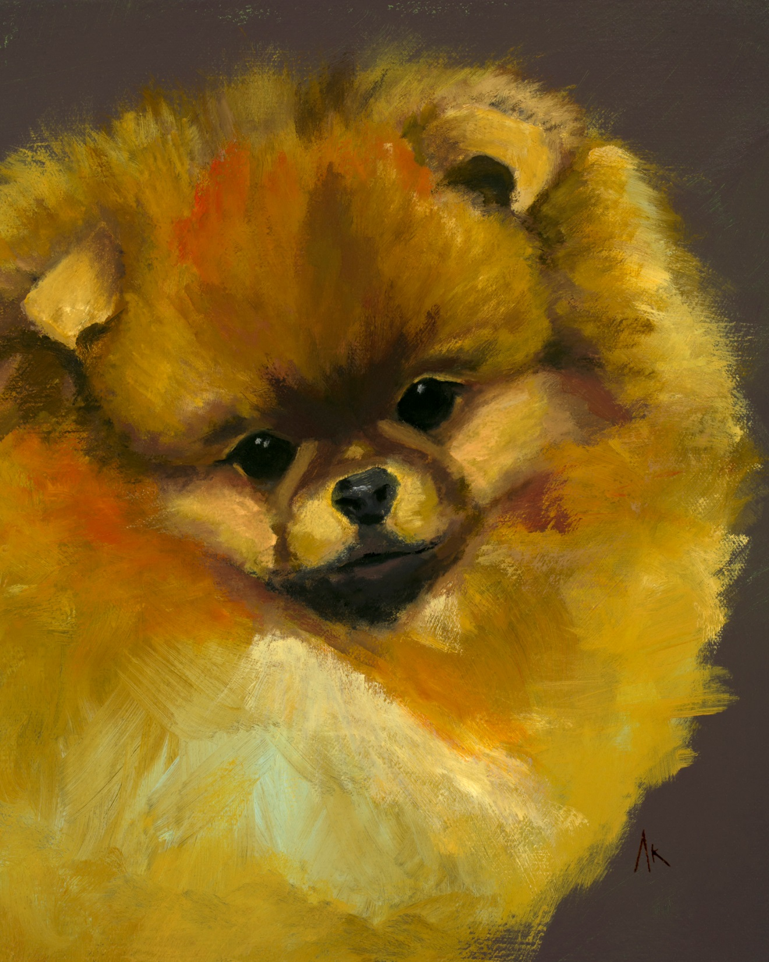
Happiness Is… Alyson Kinkade Fine Art alysonkinkade.com/happiness-is

Slide 11
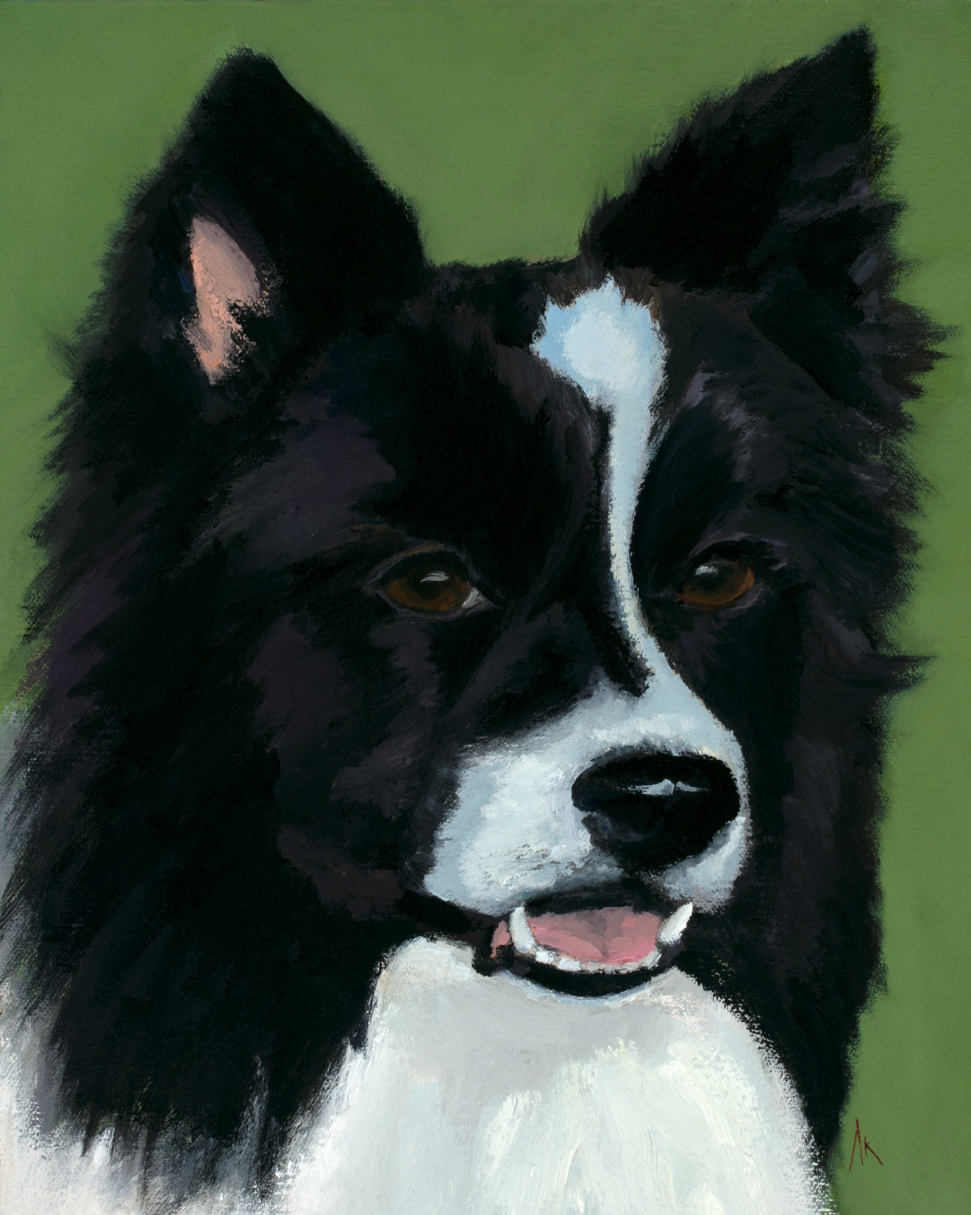
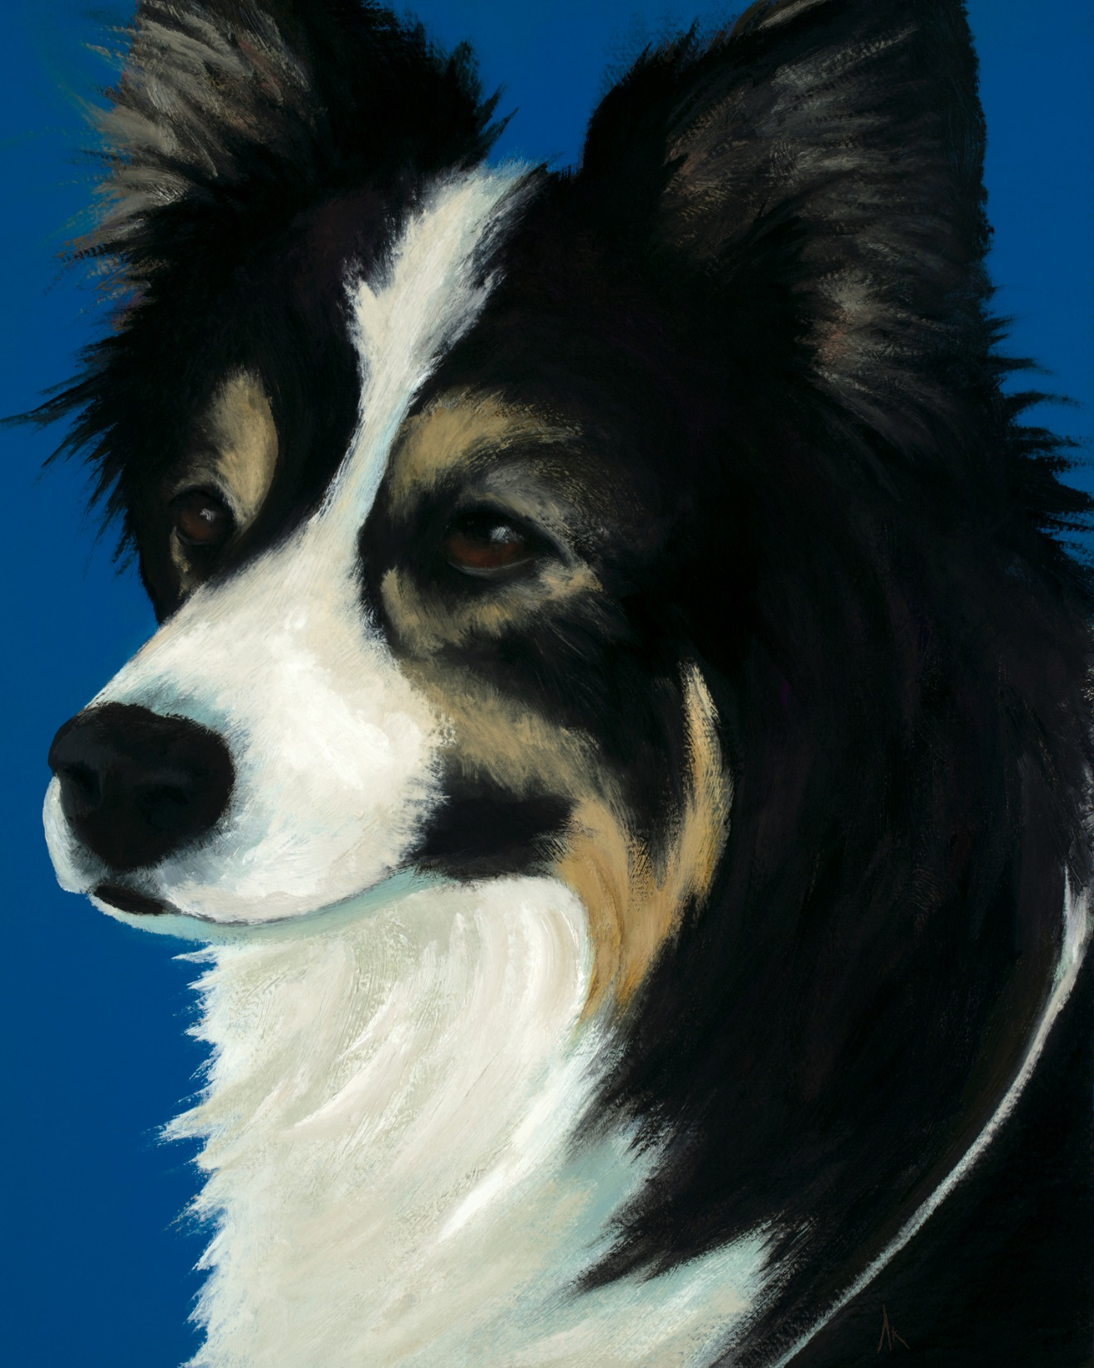
Happiness Is… Alyson Kinkade Fine Art alysonkinkade.com/happiness-is

Slide 12
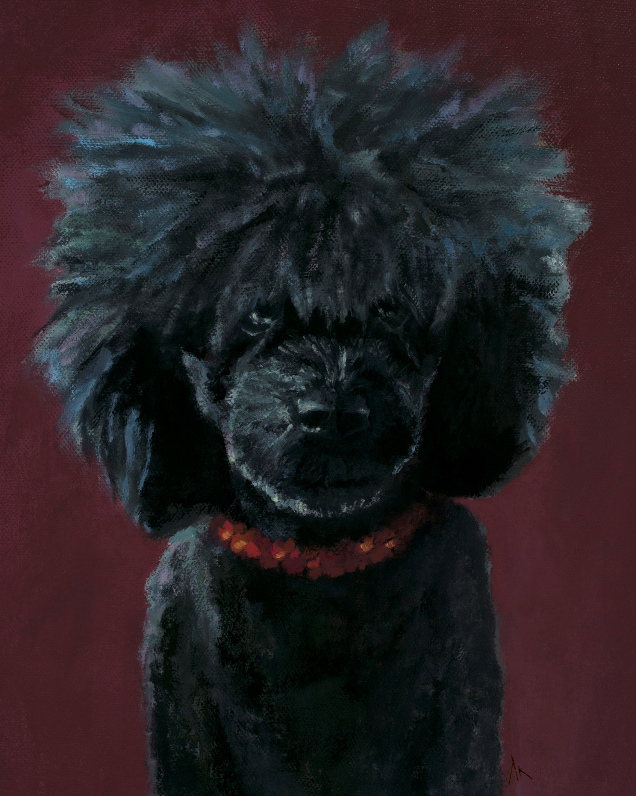
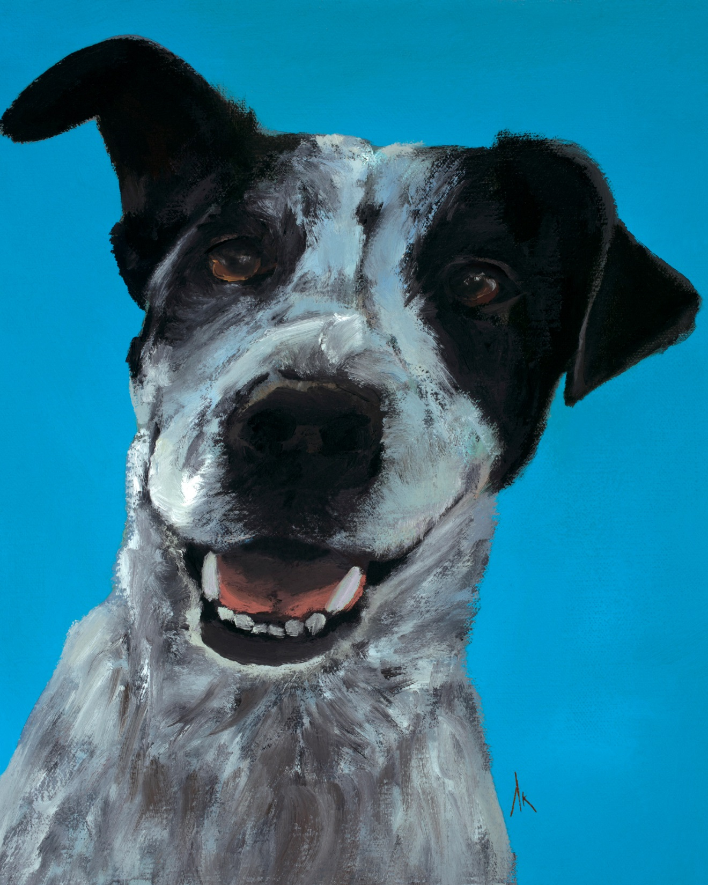
Happiness Is… Alyson Kinkade Fine Art alysonkinkade.com/happiness-is

Slide 13
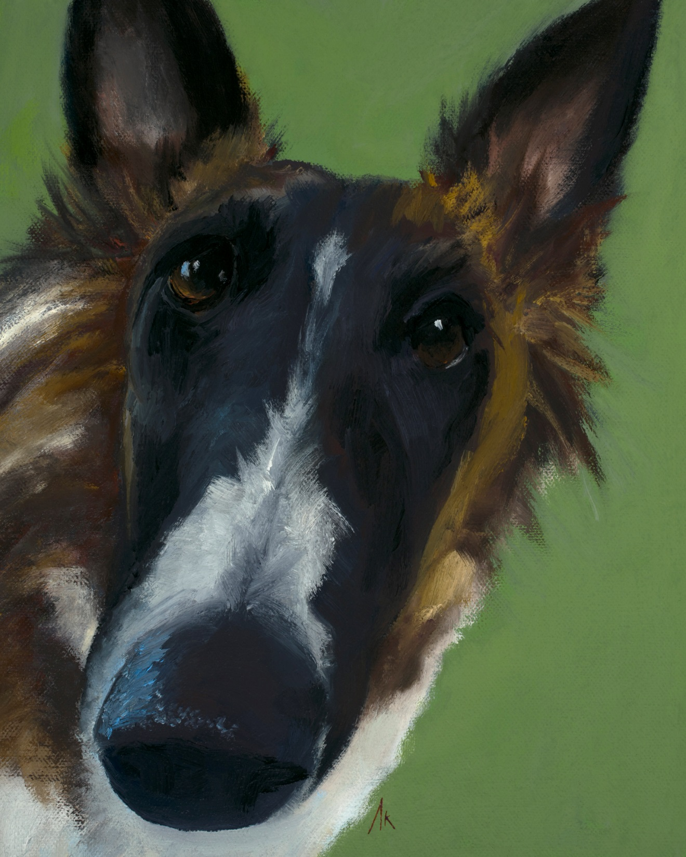
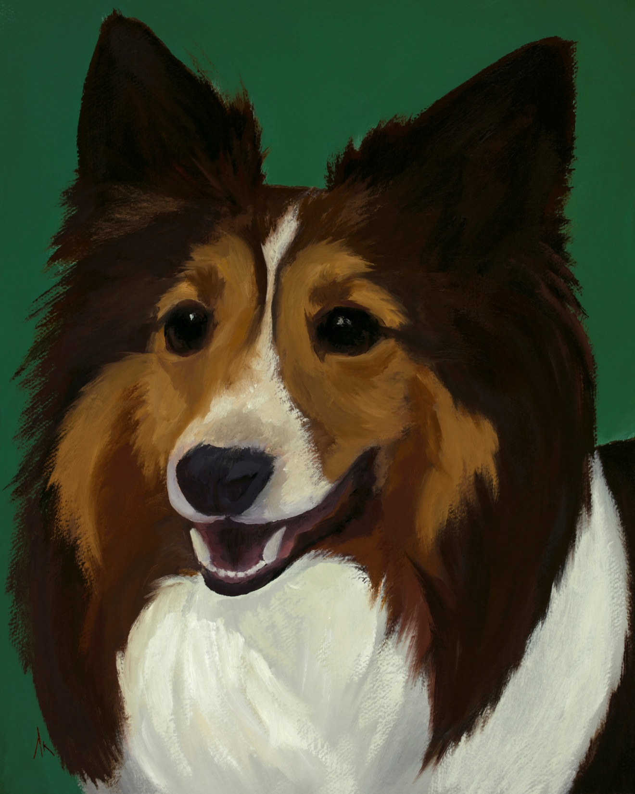
Happiness Is… Alyson Kinkade Fine Art alysonkinkade.com/happiness-is

Slide 14
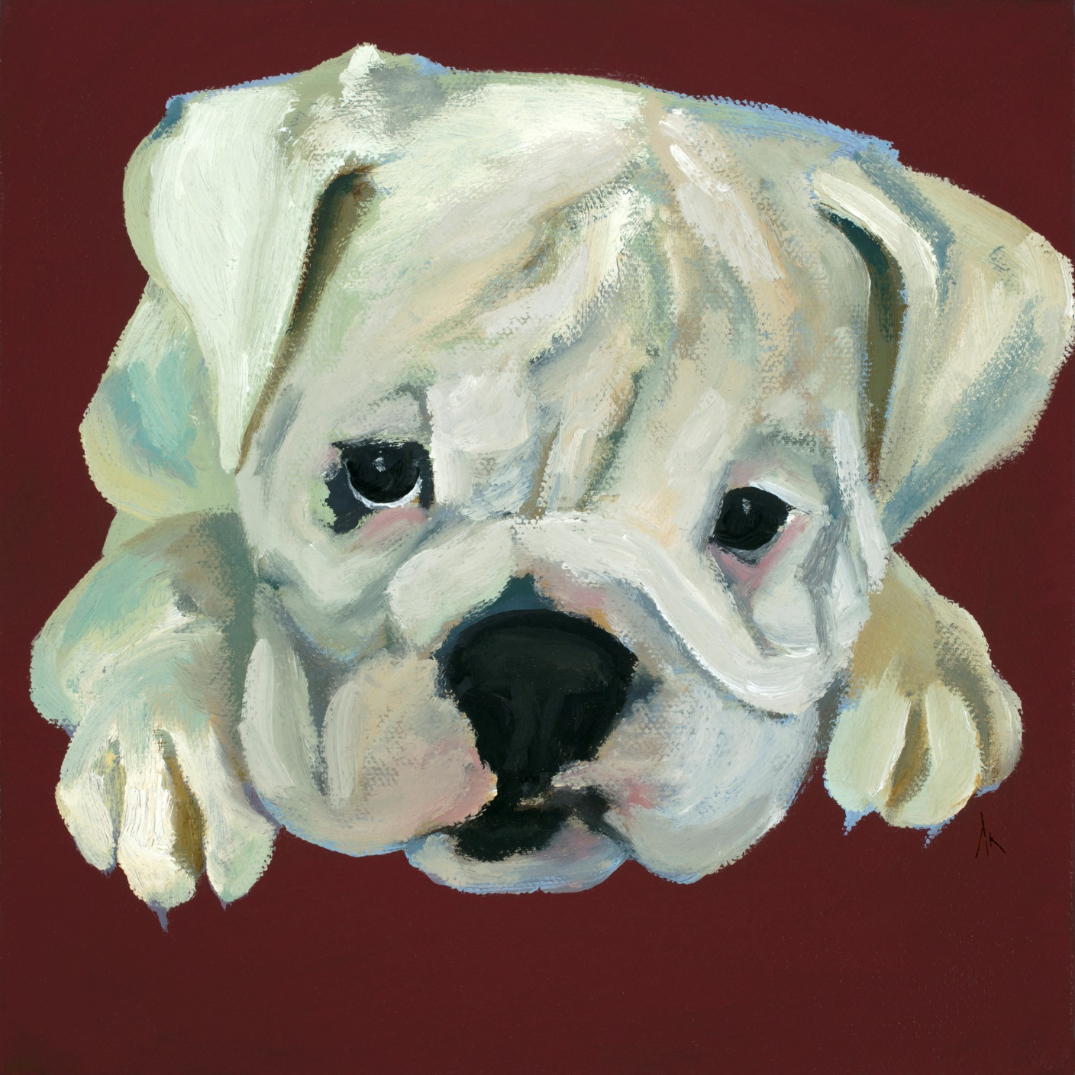
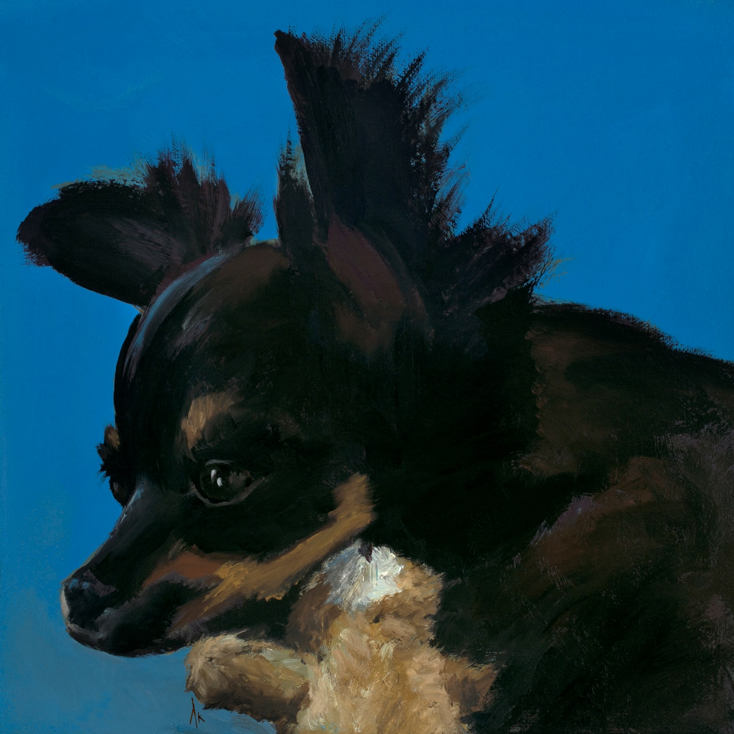
Happiness Is… Alyson Kinkade Fine Art alysonkinkade.com/happiness-is

Slide 15
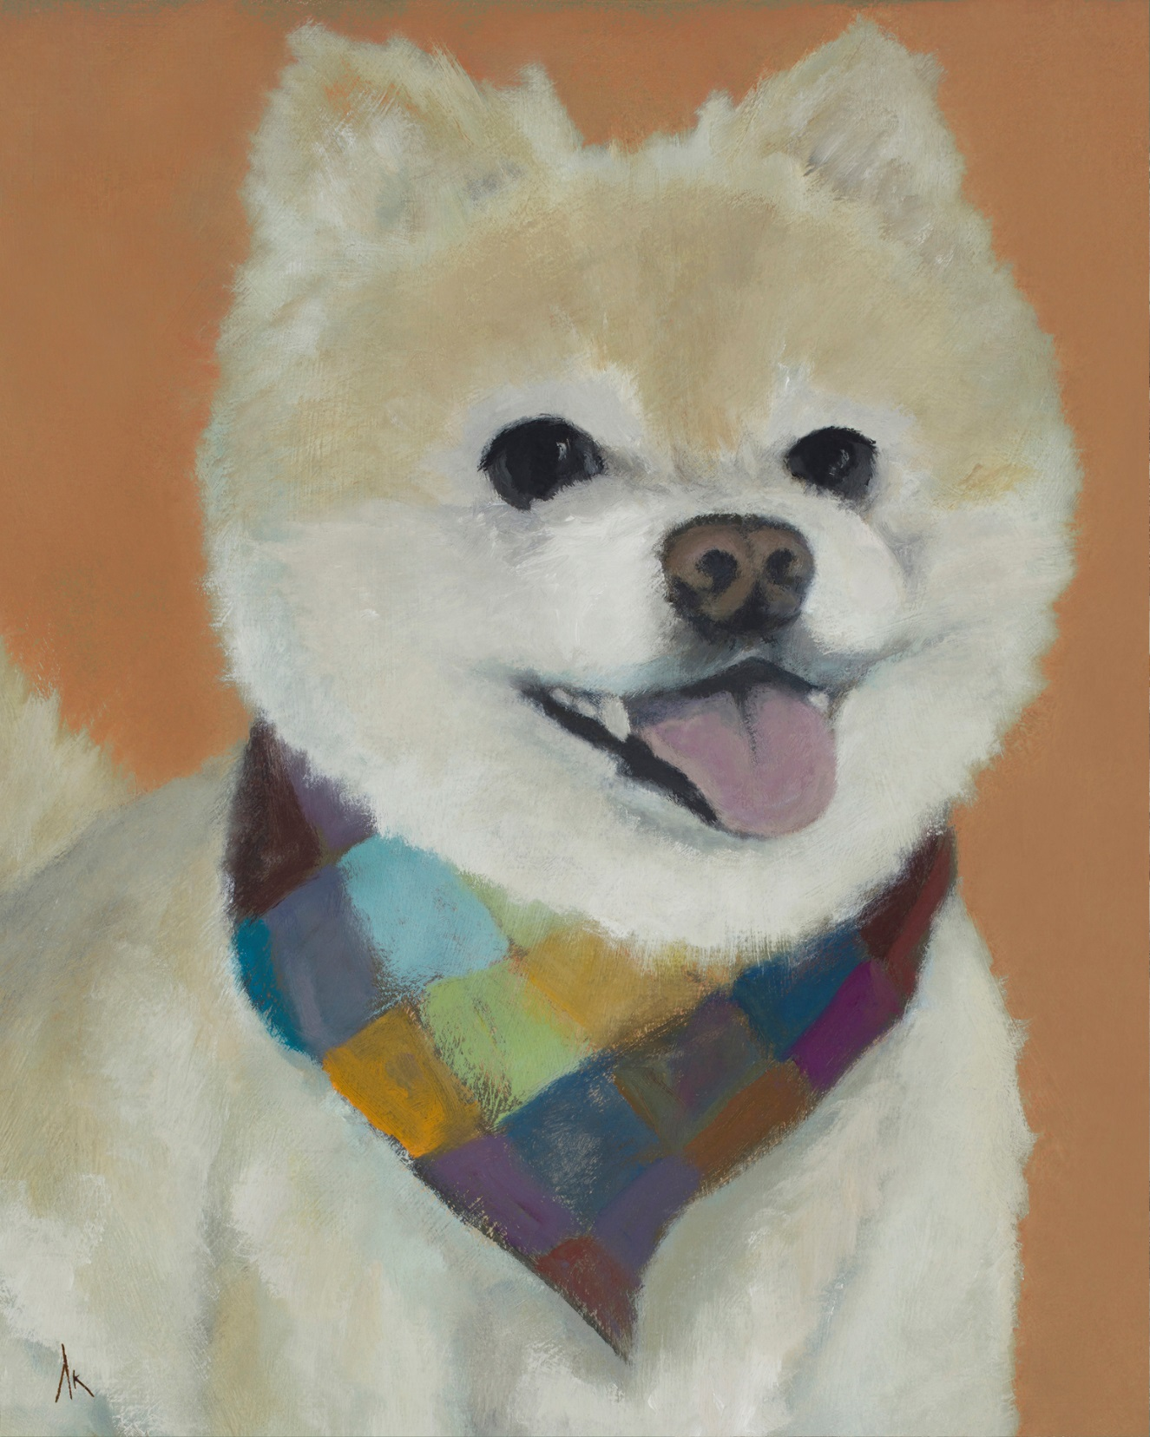
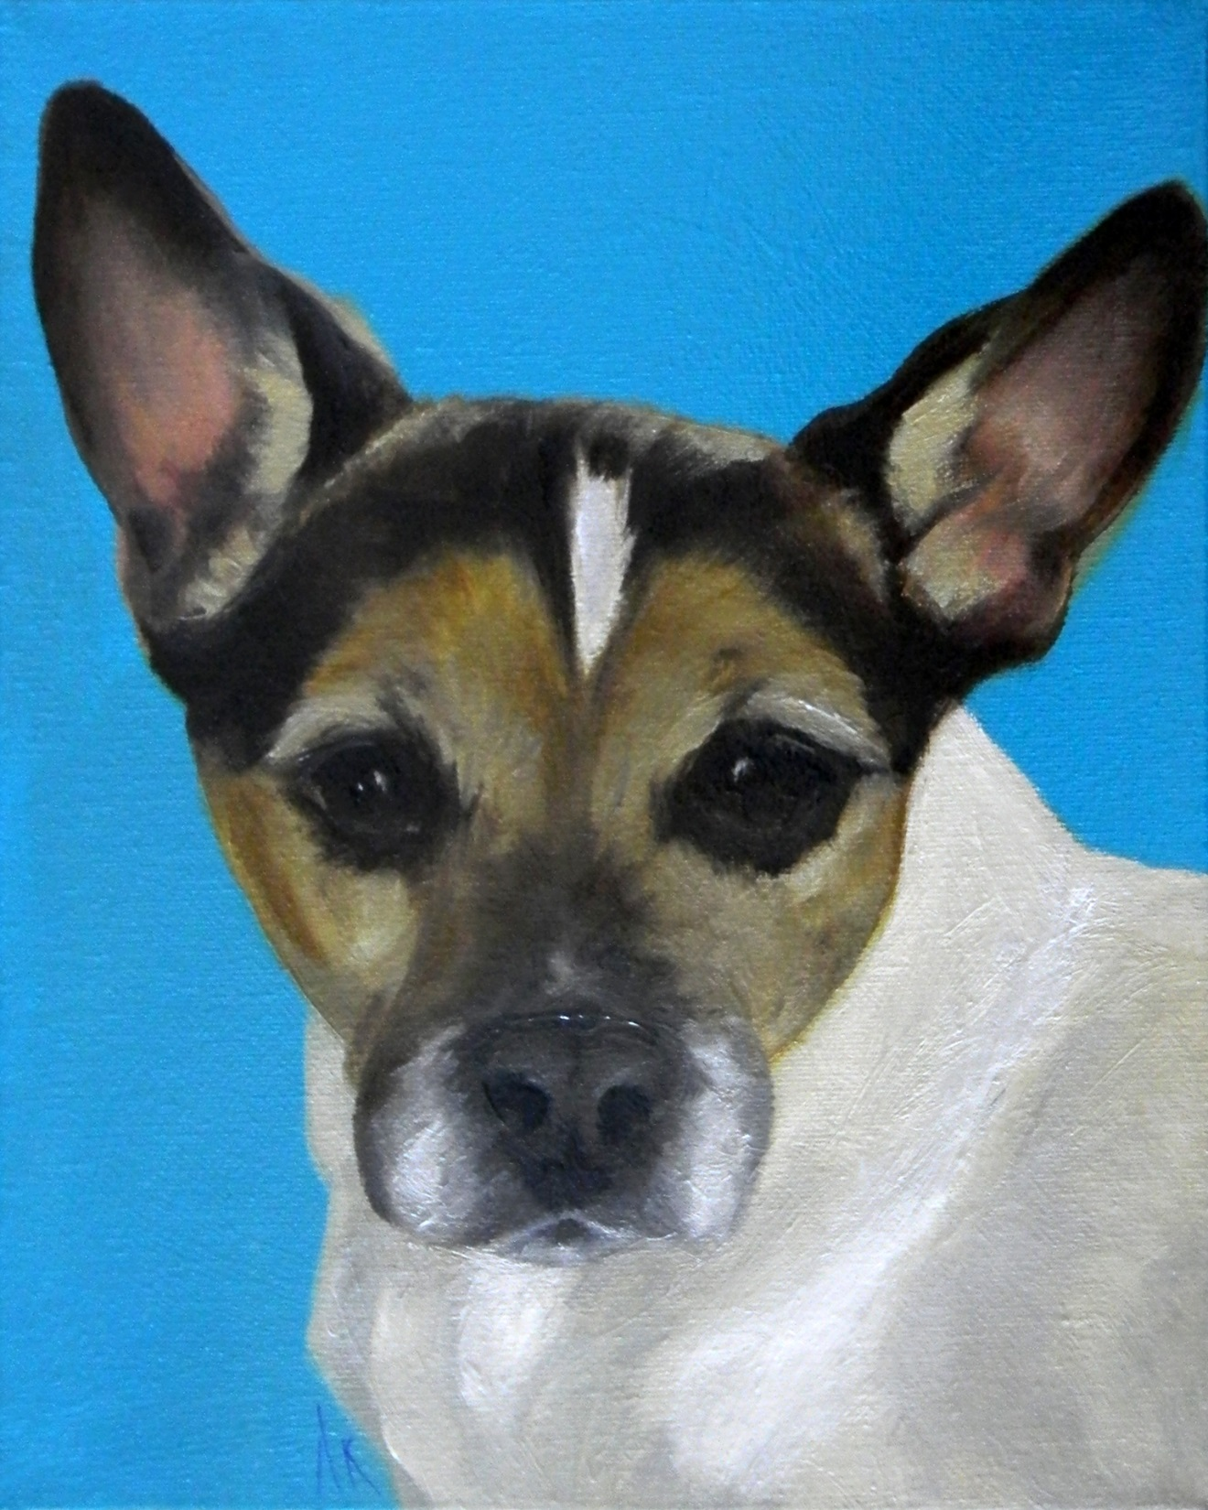
Happiness Is… Alyson Kinkade Fine Art alysonkinkade.com/happiness-is

Slide 16
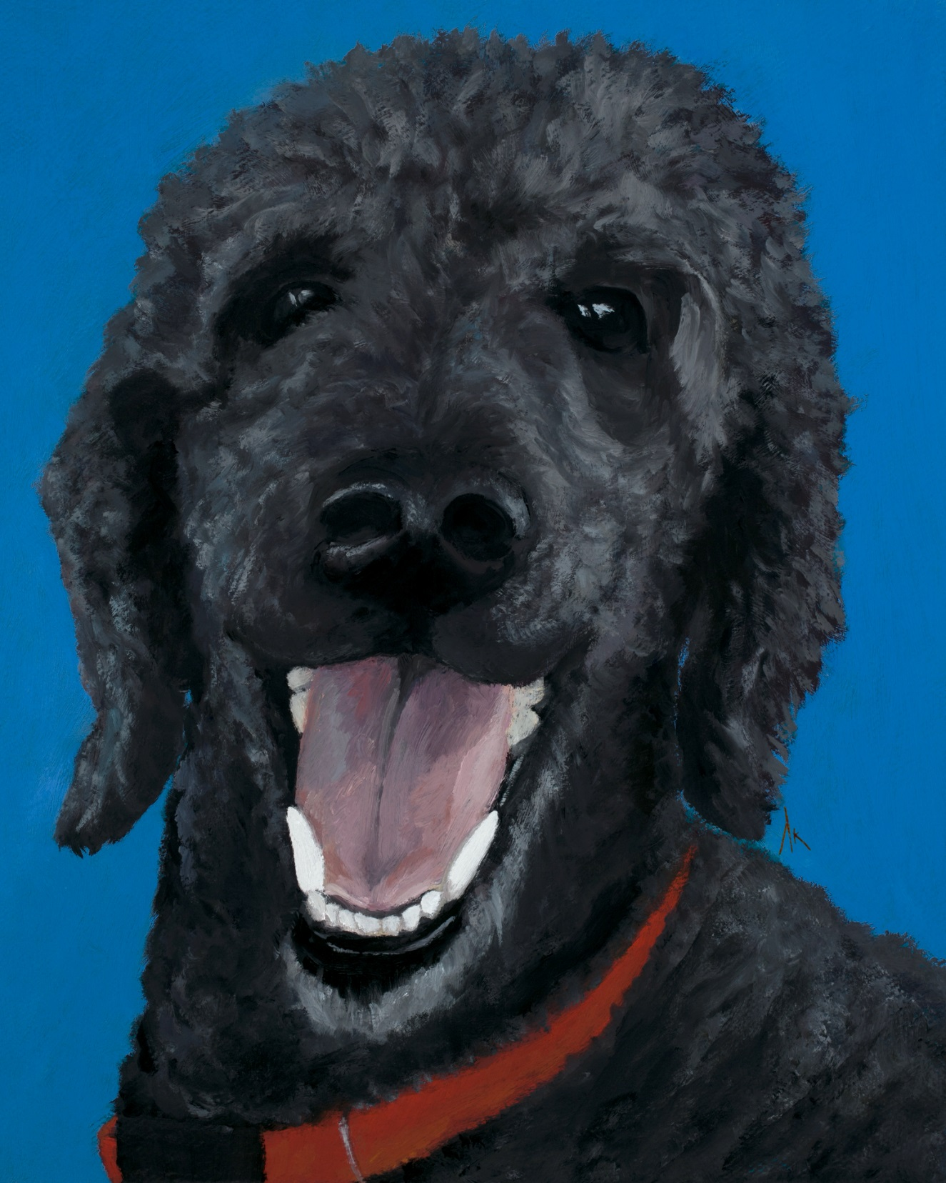
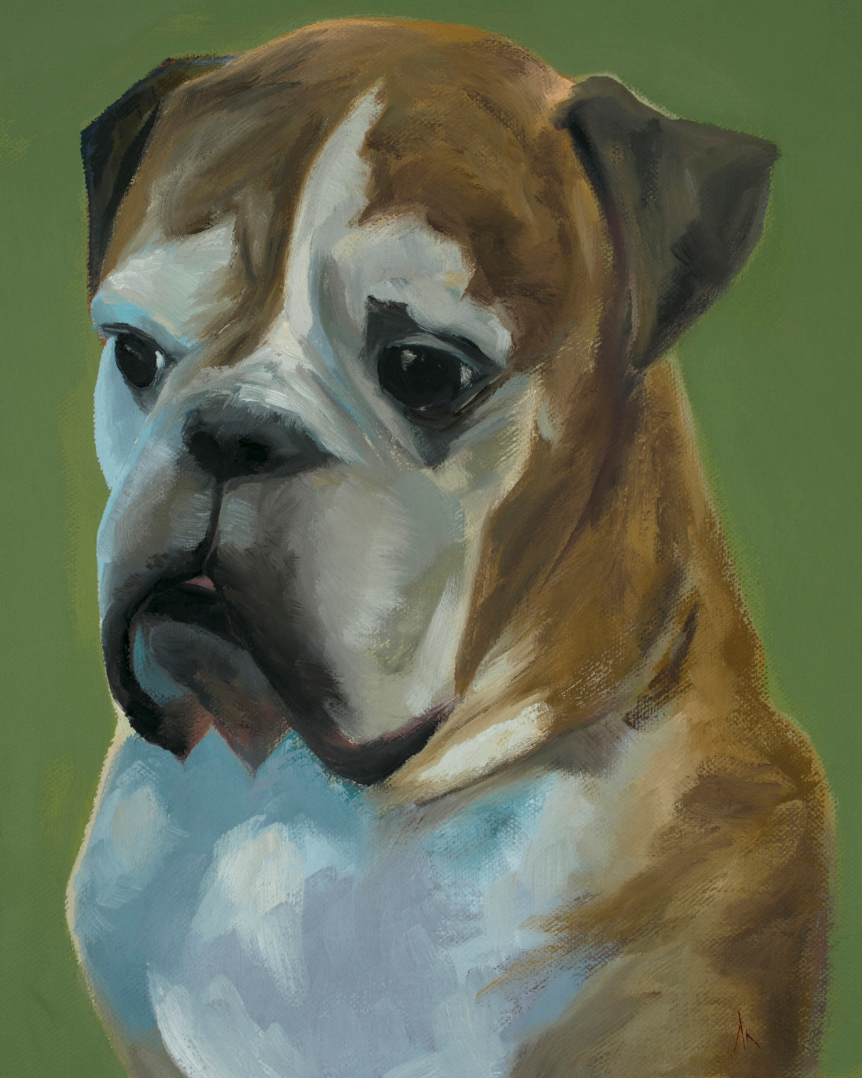
Happiness Is… Alyson Kinkade Fine Art alysonkinkade.com/happiness-is

Slide 17
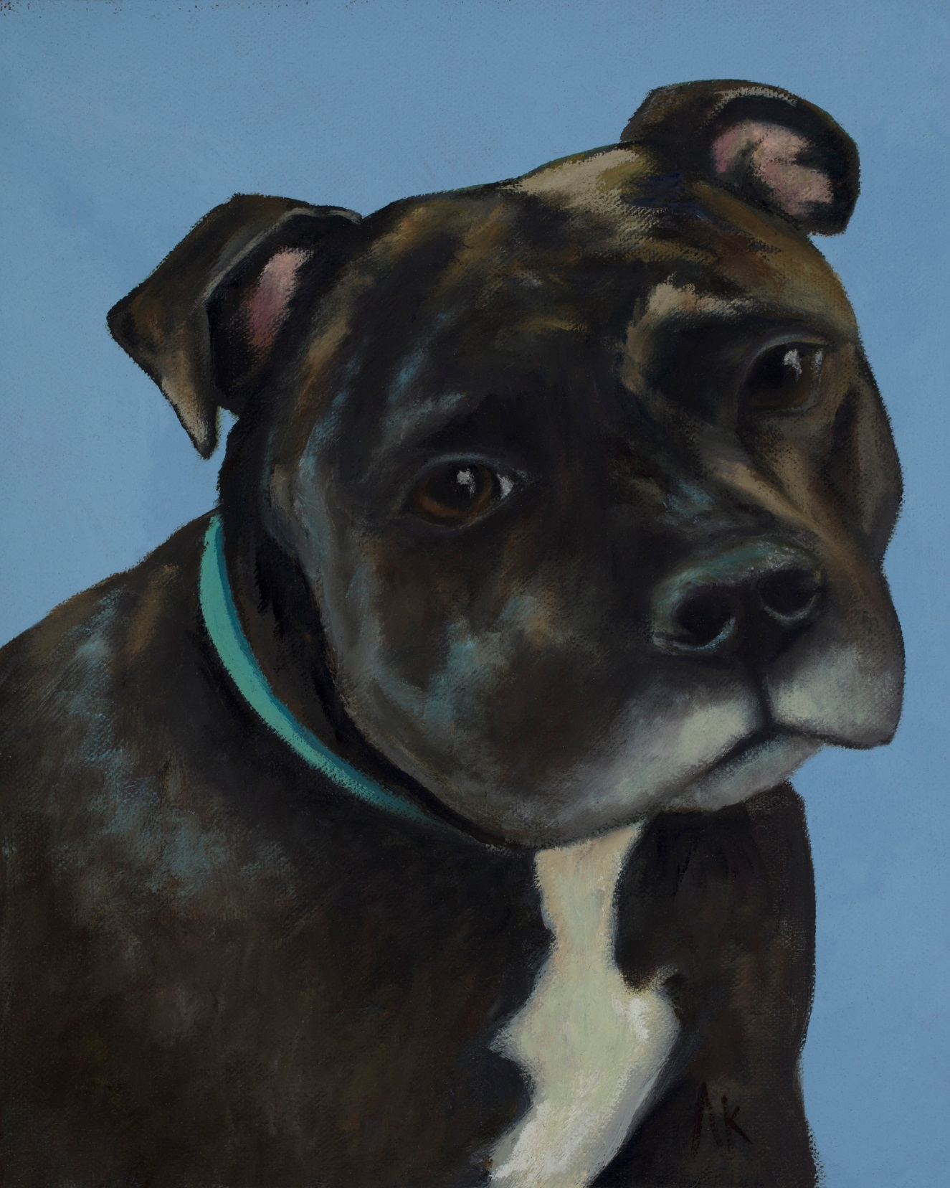
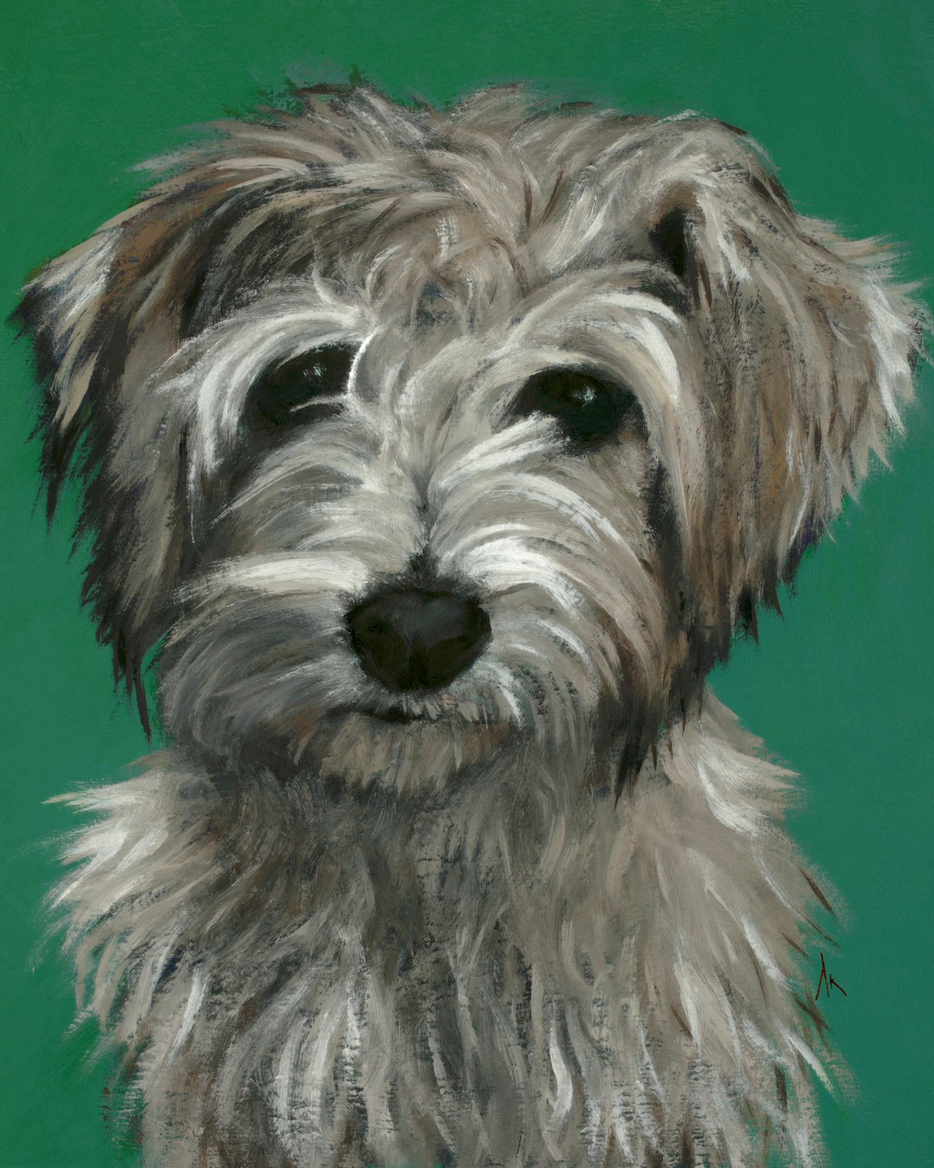
Happiness Is… Alyson Kinkade Fine Art alysonkinkade.com/happiness-is

Slide 18
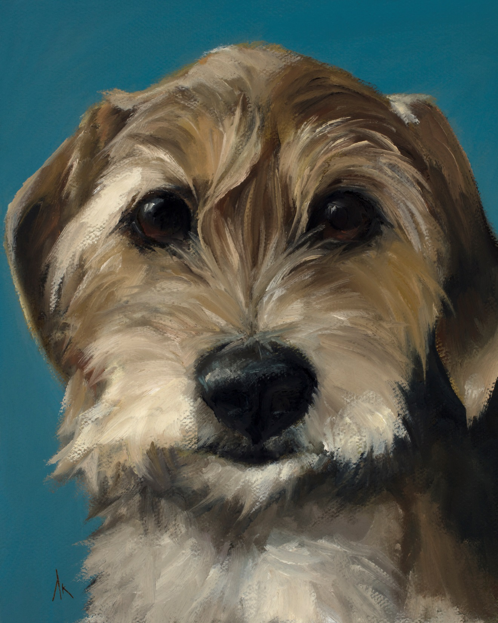
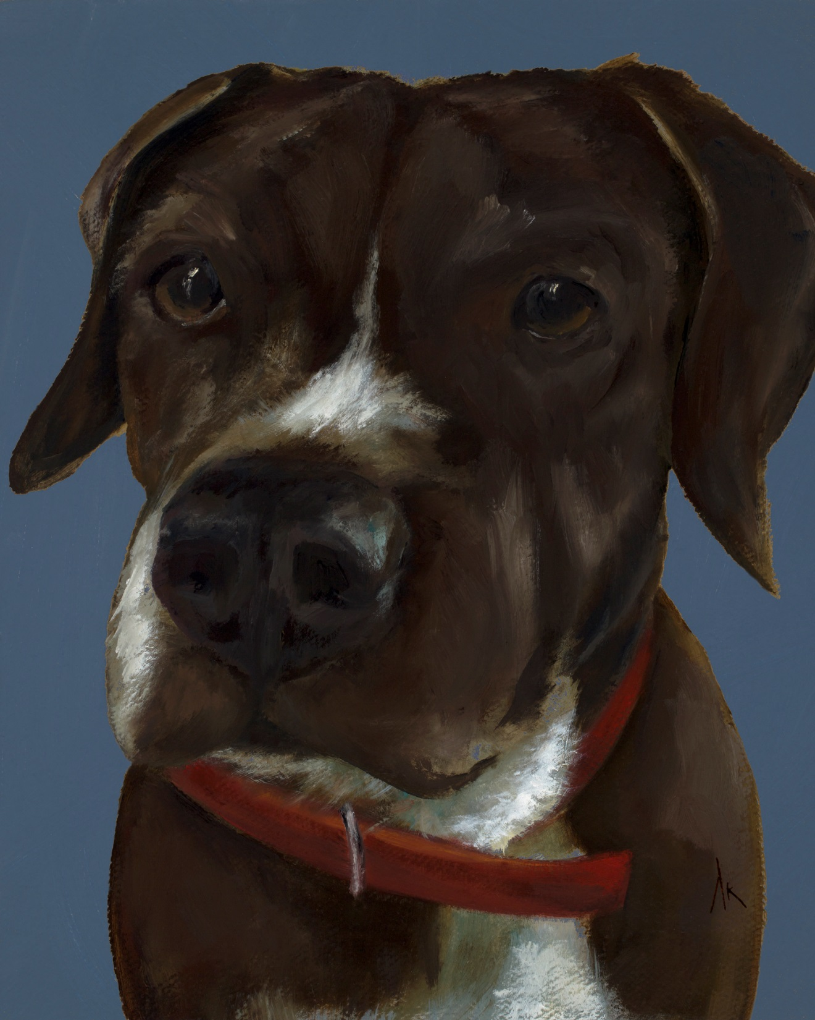
Happiness Is… Alyson Kinkade Fine Art alysonkinkade.com/happiness-is

Slide 19
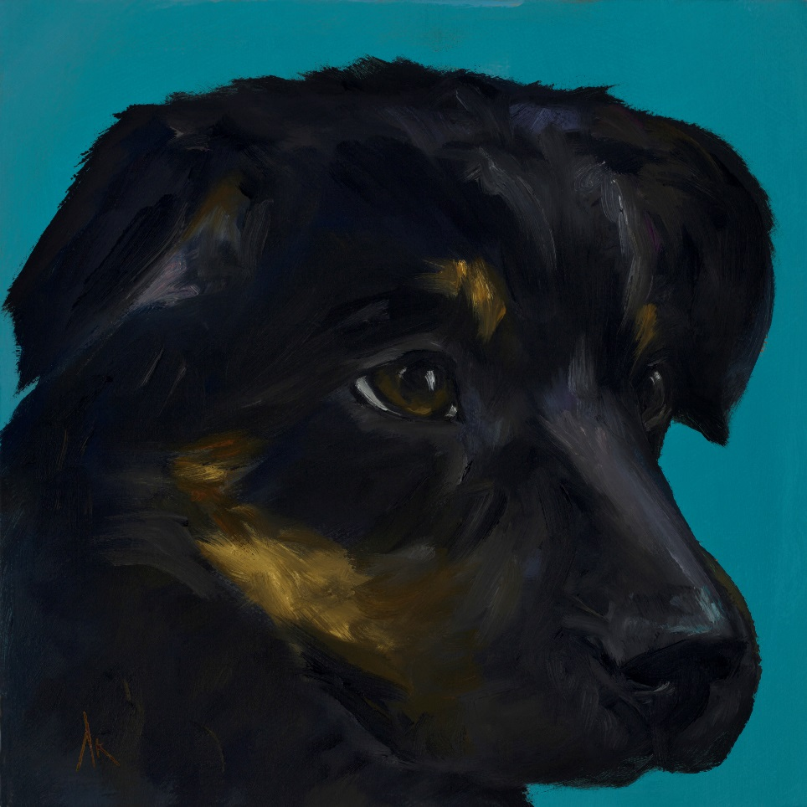
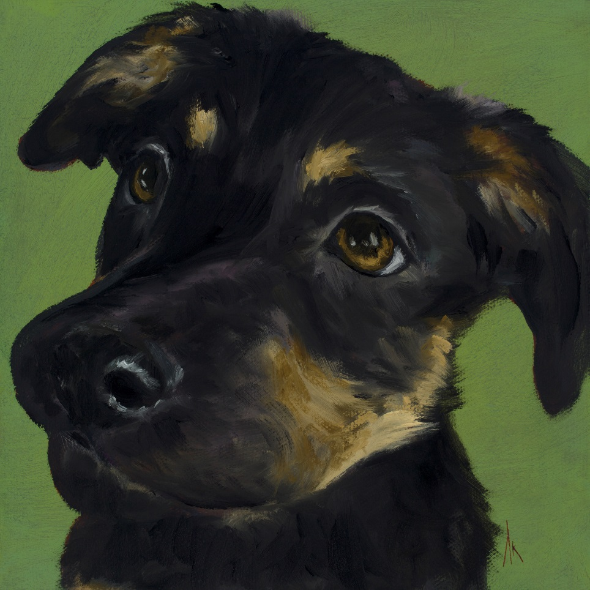
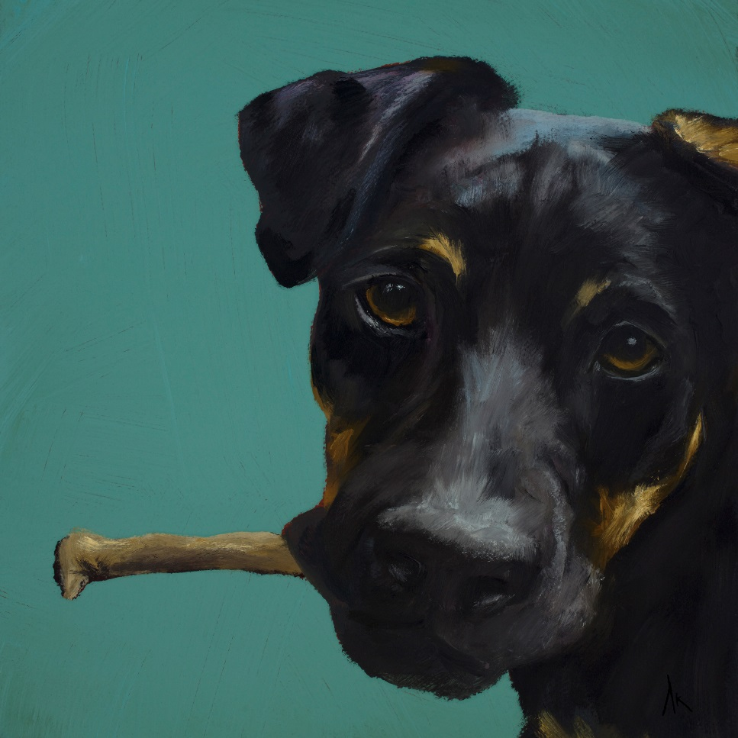
Happiness Is… Alyson Kinkade Fine Art alysonkinkade.com/happiness-is

Slide 20
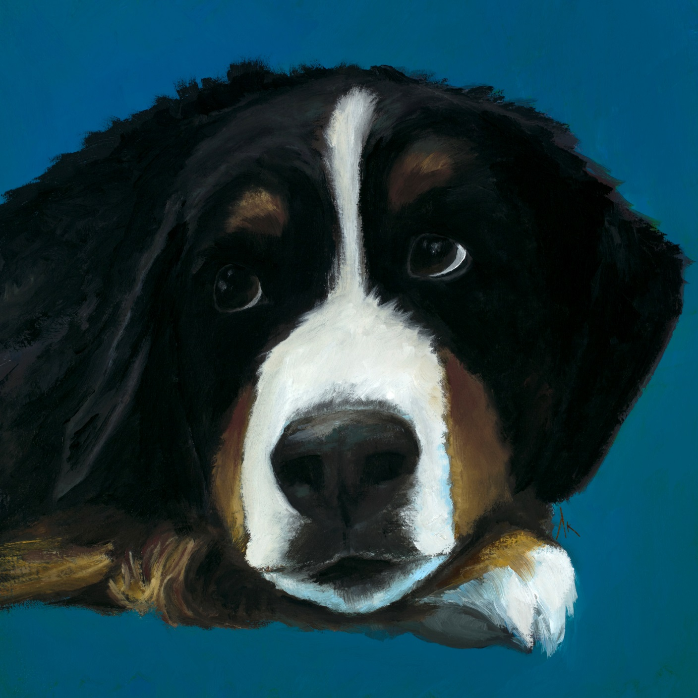
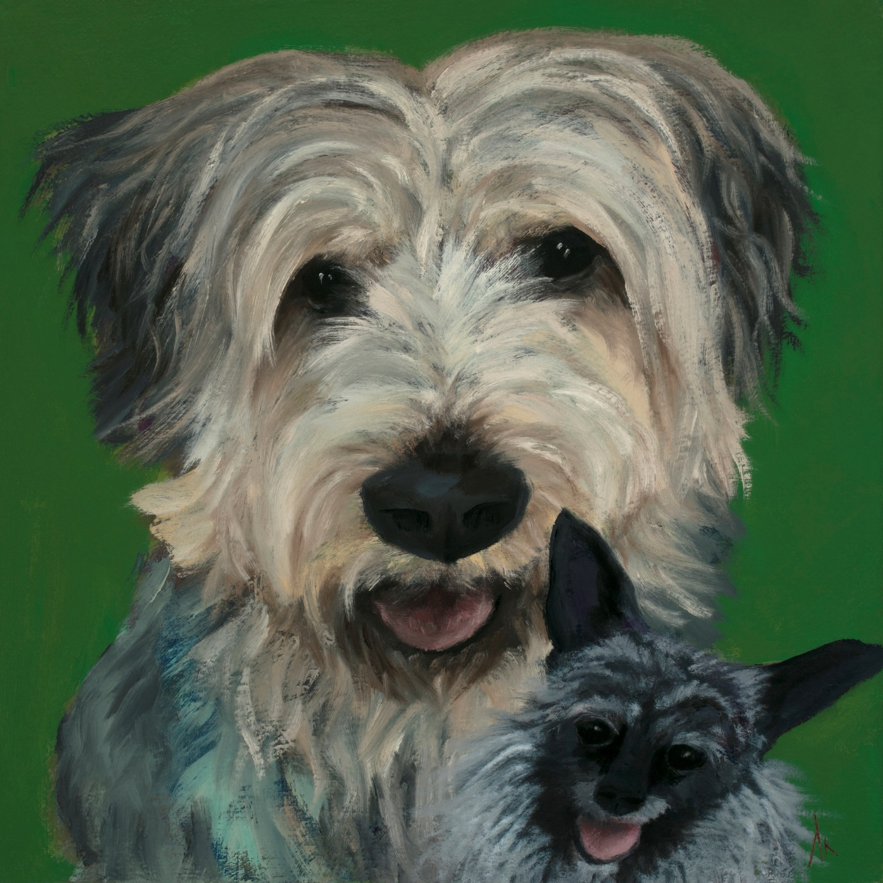
Happiness Is… Alyson Kinkade Fine Art alysonkinkade.com/happiness-is

Slide 21
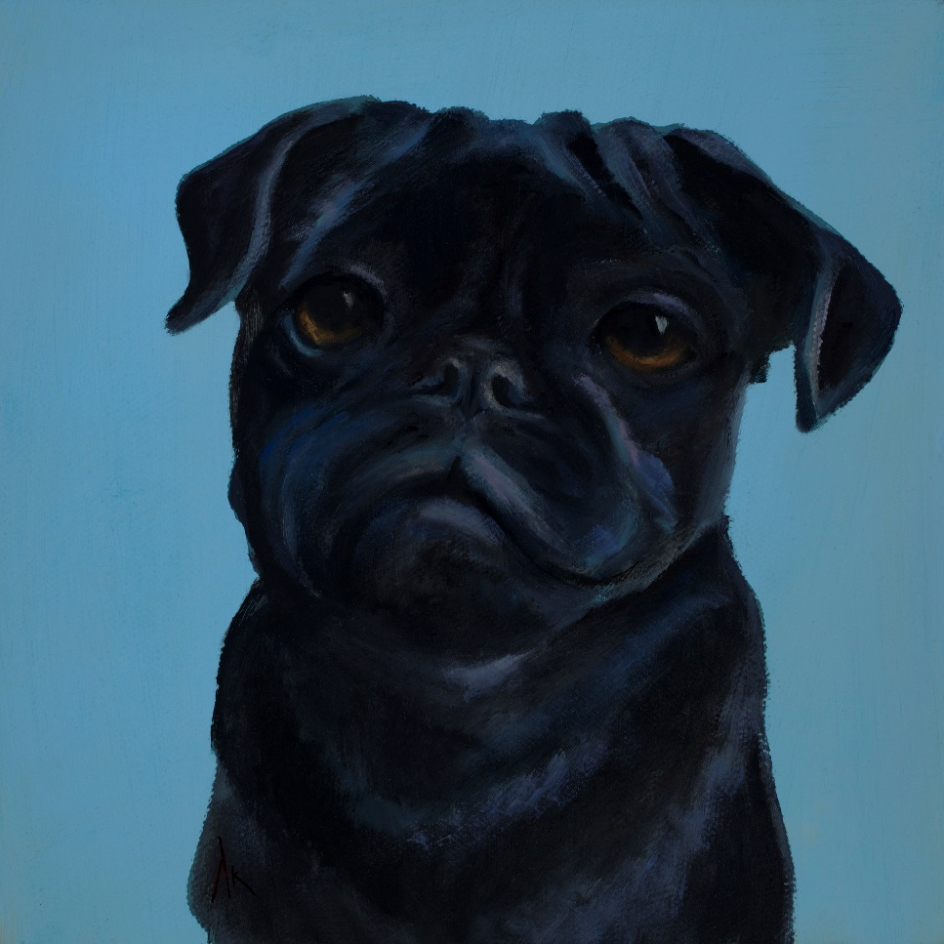
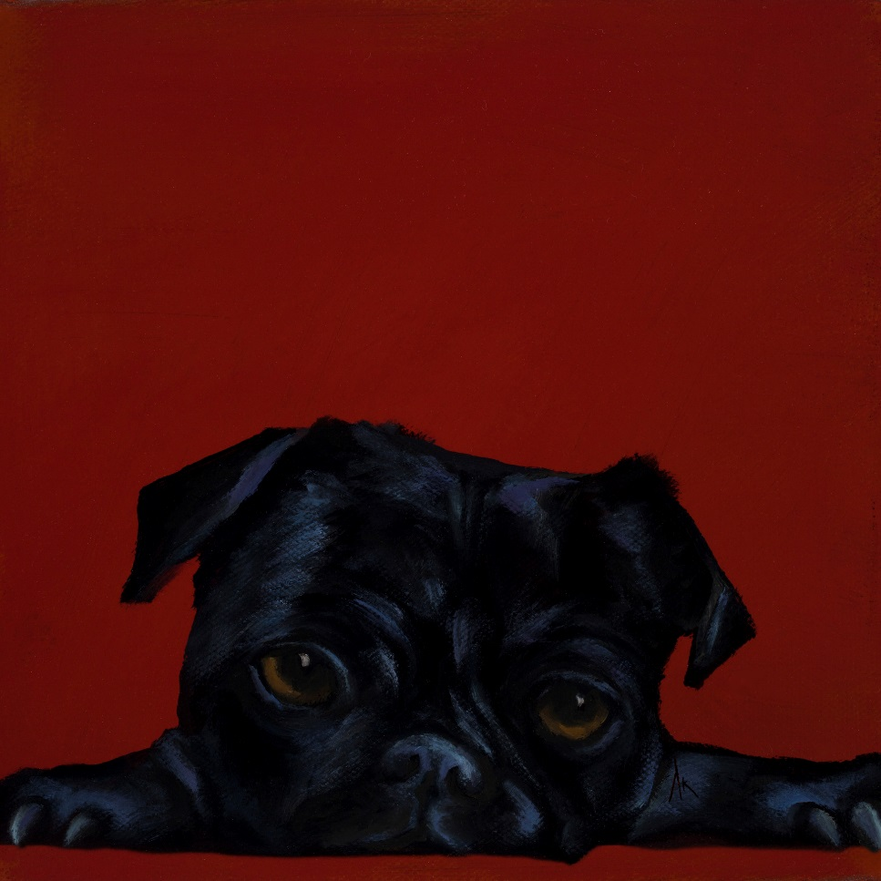
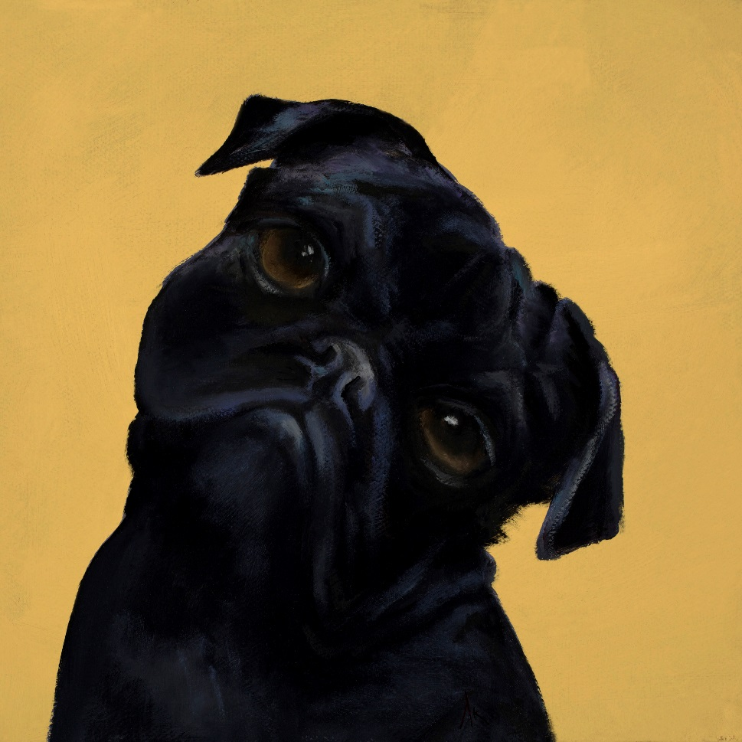
Happiness Is… Alyson Kinkade Fine Art alysonkinkade.com/happiness-is

Slide 22
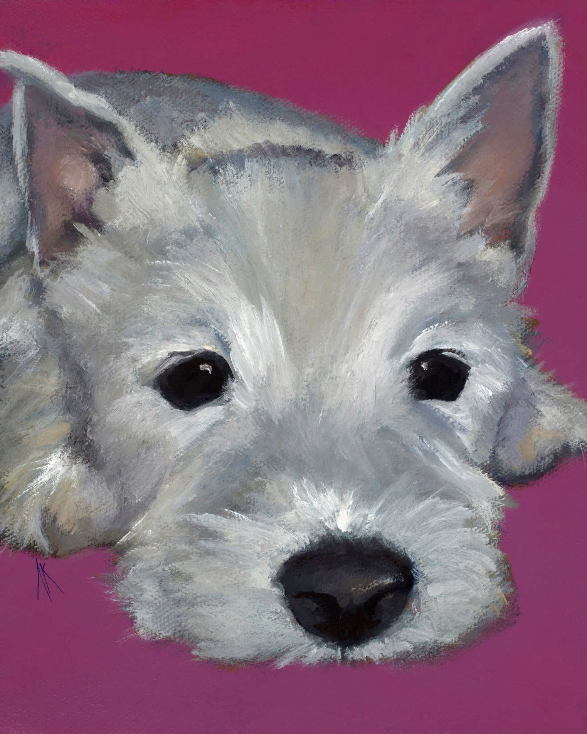
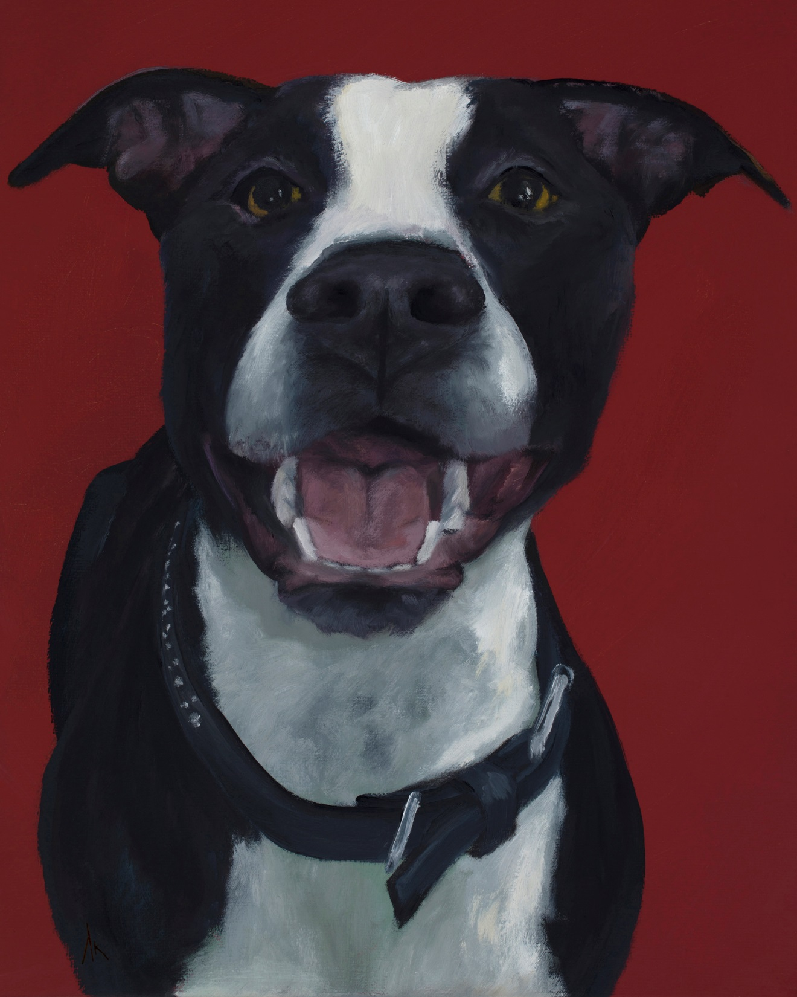
Happiness Is… Alyson Kinkade Fine Art alysonkinkade.com/happiness-is

Slide 23
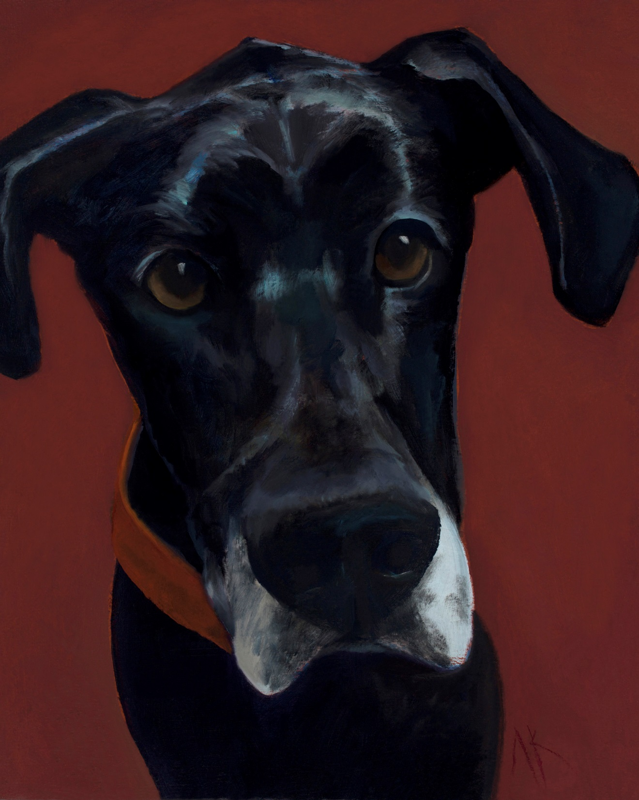
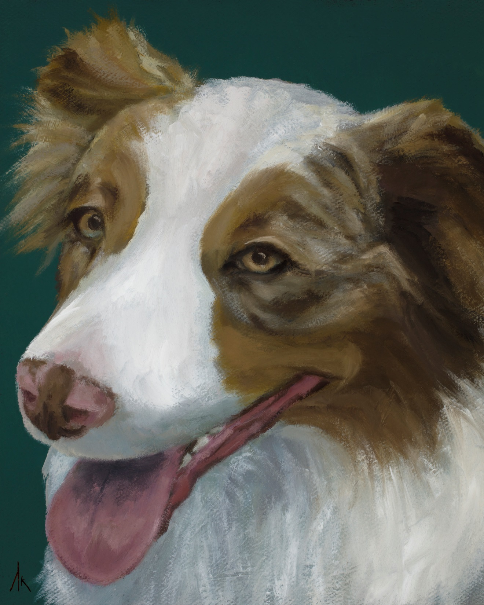
Happiness Is… Alyson Kinkade Fine Art alysonkinkade.com/happiness-is

Slide 24
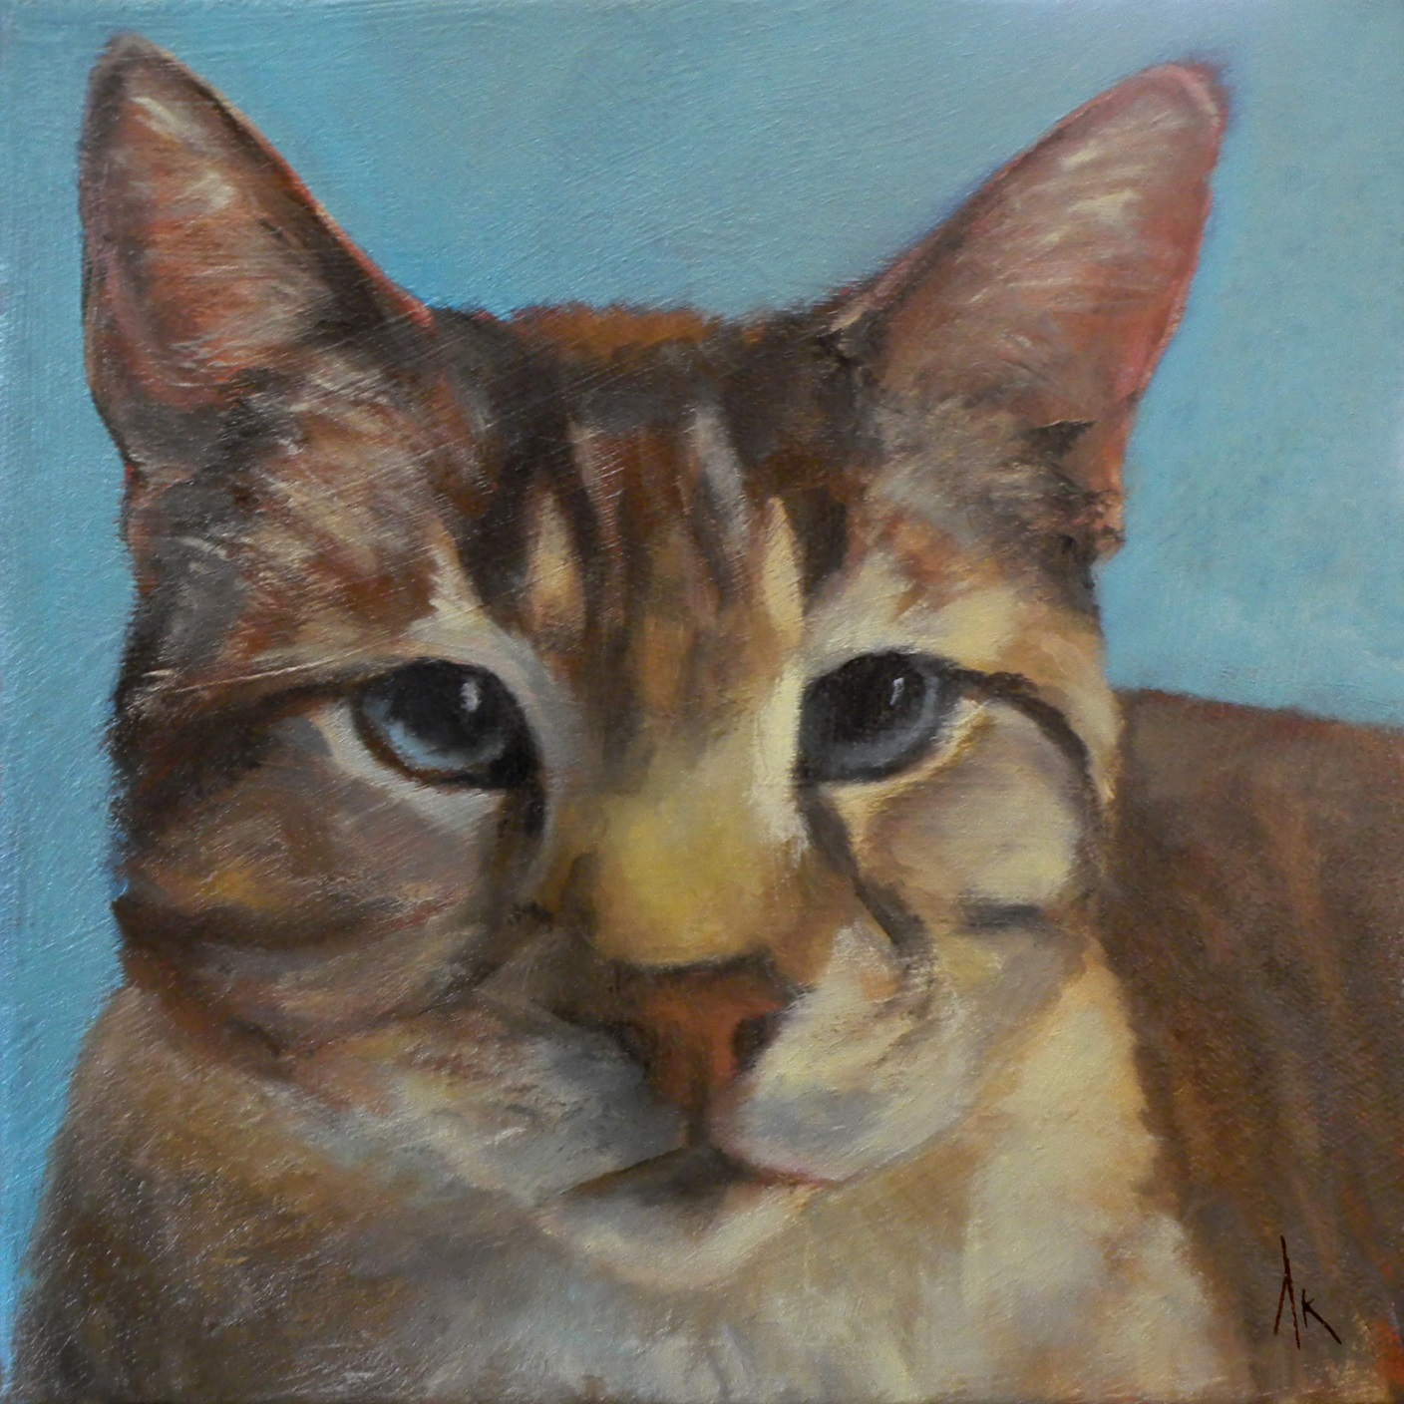
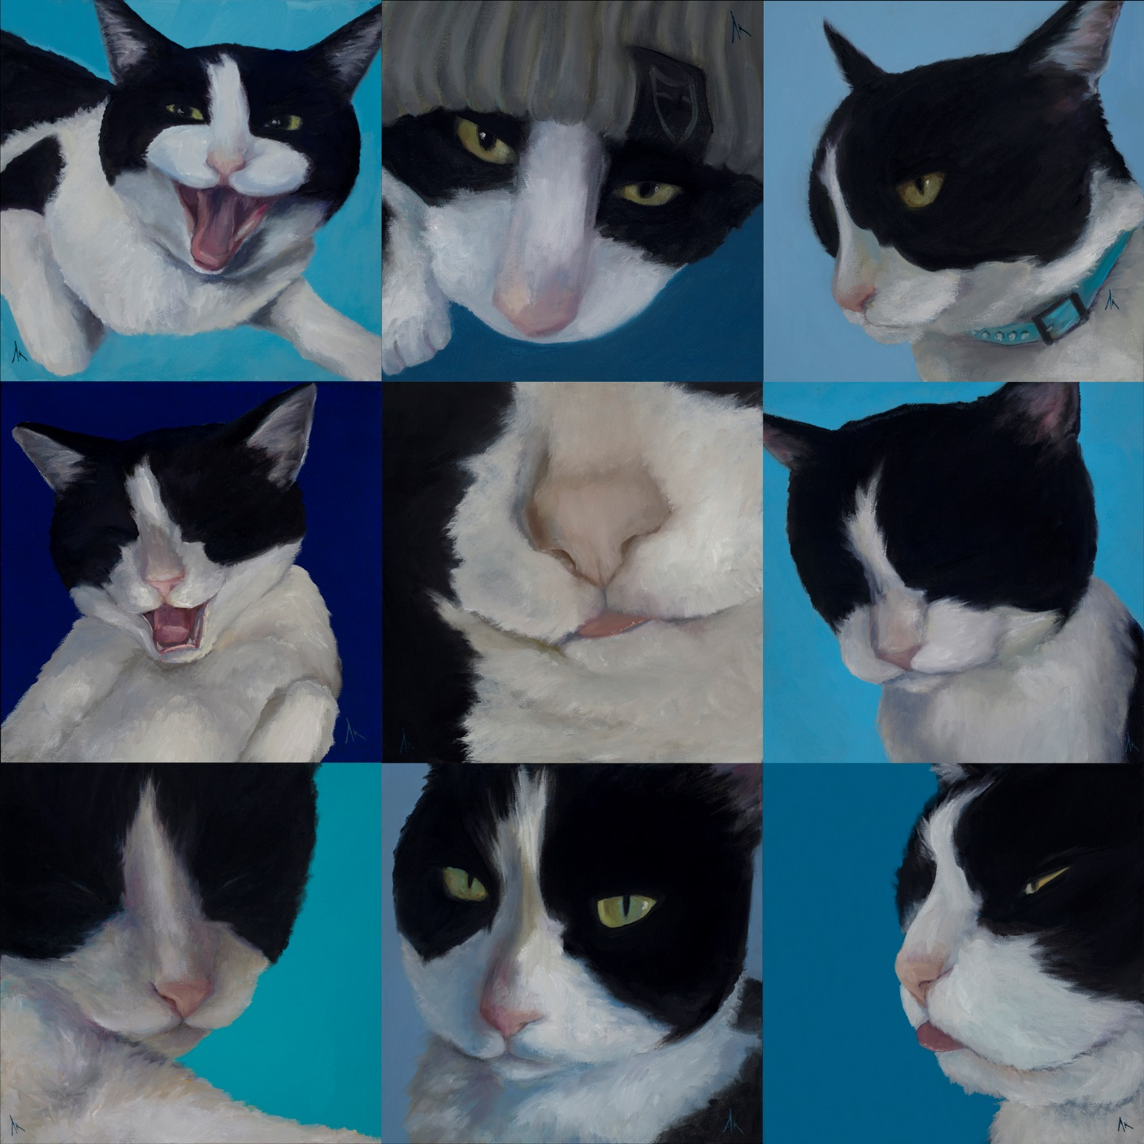
Nine Lives… Alyson Kinkade Fine Art alysonkinkade.com/nine-lives

Slide 25
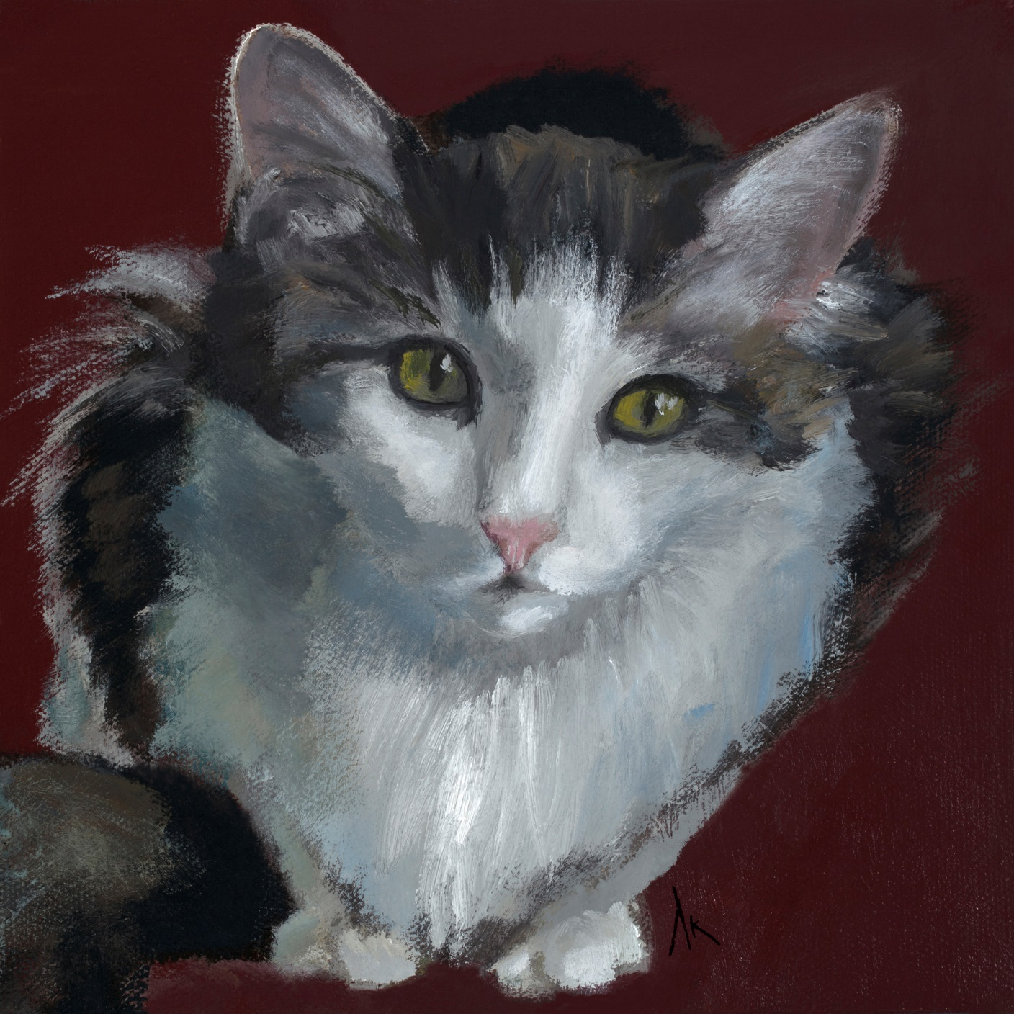
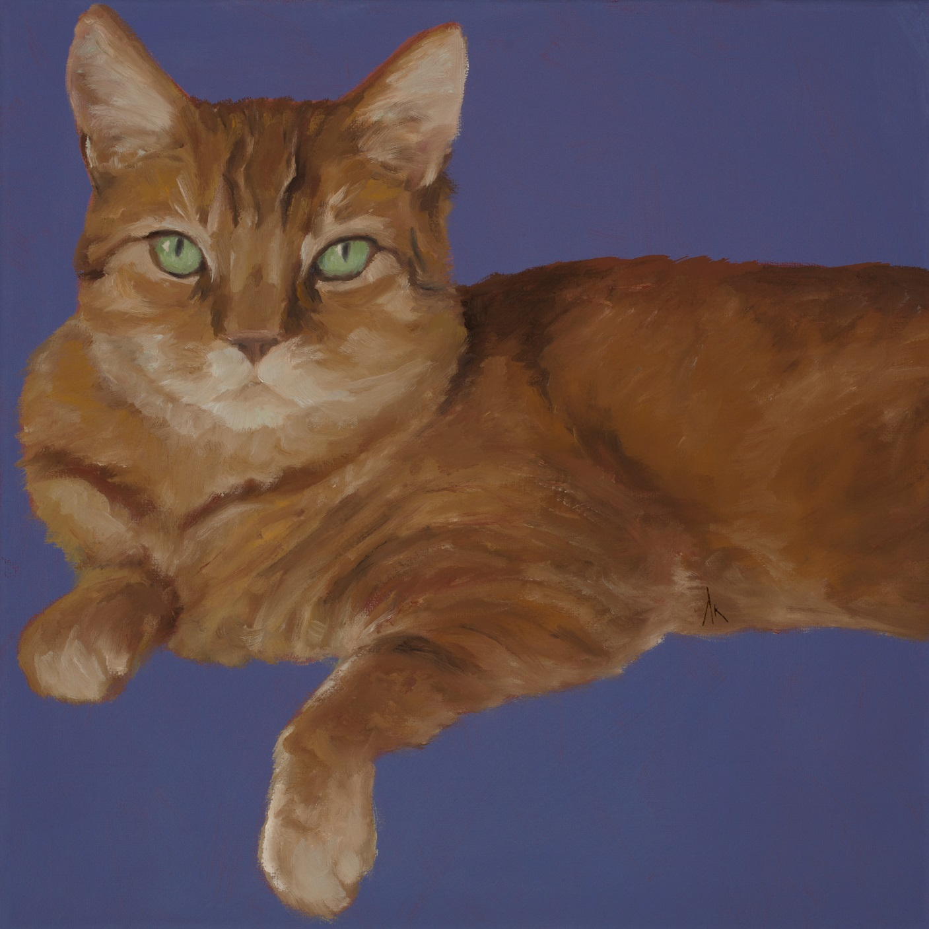
Nine Lives… Alyson Kinkade Fine Art alysonkinkade.com/nine-lives

Slide 26
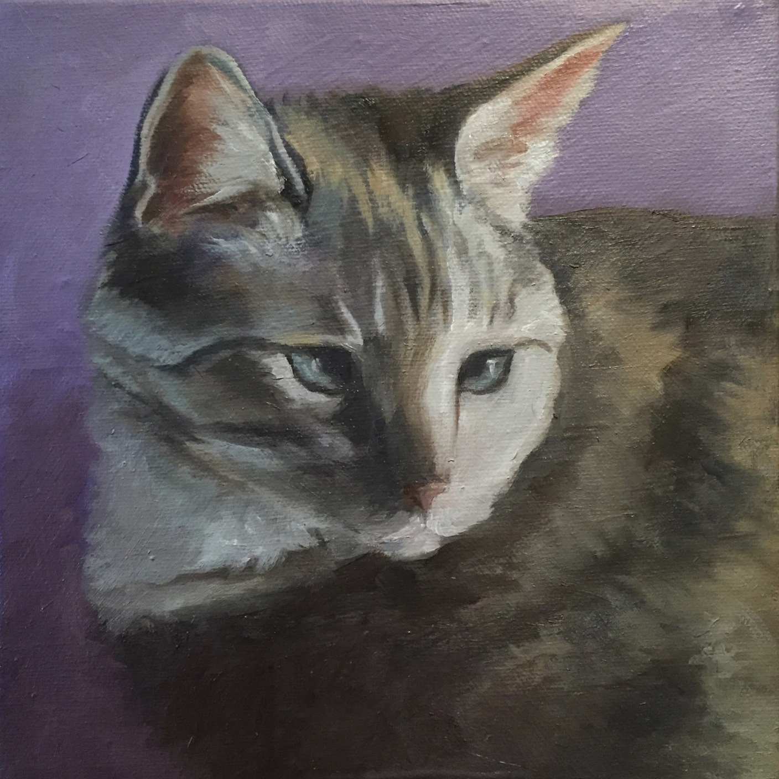
Nine Lives… Alyson Kinkade Fine Art alysonkinkade.com/nine-lives

Slide 27
Happiness Is… & Nine Lives
Pet Portraits by Alyson Kinkade
Alyson Kinkade Fine Art alysonkinkade.com

